Slide 1

BASIC
Instruction
Teaching Principles

Slide 2

BASIC
BEHAVIOR
Attendance
Technology
Mutual Respect
ASSESSMENT
Formative
Summative
Quizzes
SEQUENCE (WHEN)
WPPPW
INSTRUCTION (HOW)
Instructional Practices
Techniques
Methodology
CONTENT (WHAT)
CURRICULUM
iCANS
Topics/Units

Slide 3

BEHAVIOR
GROUND RULES
Decide in advance, discuss with students in class and post in syllabus
1-Attendance & Tardies
2-Coming late or leaving early for another class
3-Technology Use
4-Mutual Respect
(talking over instructor)
5-Dominators (D & C 88: 122)
Appoint among yourselves a teacher, and let not all be spokesmen at once; but let one speak at a time and let all listen unto his sayings, that when all have spoken that all may be edified of all, and that every man may have an equal privilege.

Slide 4

Assessments
Formative-low stakes
Low or no point value/grade
Help student identify strengths and weaknesses
Help instructors recognize where students are struggling in order to review concepts of weakness
Examples:
Quizzes
Partner/Group Activities
Games
Projects
Presentations

Slide 5
Assessments
Summative-high stakes
Graded
Evaluate student learning at the end of a unit/time period/semester
Instructors use for student learning against the expected standard
Examples:
Mid-term exam
Final Project or Essay
Final Exam
Challenge Exam

Slide 6
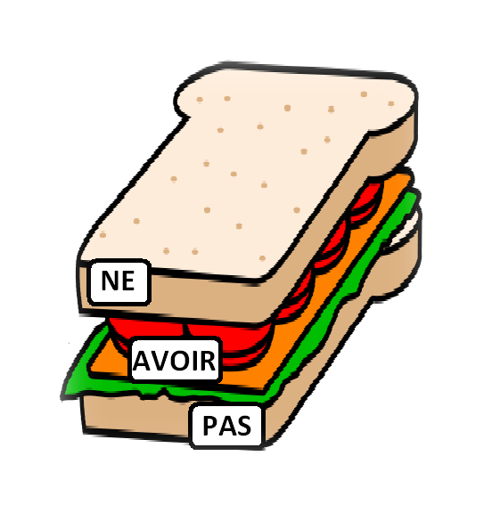
SEQUENCE-SAMPLE LESSON PLAN
WPPPW
Five Steps
1-Warm-up
2-Instructor Presentation
3-Student Practice
4-Student Product
5-Wrap-up
Warm-Up
Present, Practice, Product
Wrap-Up

Slide 7

WPPPW Example
Topic-Typical Housing
1-Warm-up House For Sale
2-Presentation on furniture and practice with partners
3A-Practice-Room Charades & Group Drawing Guess
3B-Practice Partners Draw Furniture in rooms
4-Product-Group Recording of one-minute role-play renting an apartment or buying house with rooms and furniture
5-Wrap-up Play Group recordings to class

Slide 8

Maison à Vendre
Adjectifs
Elégante
Fantastique
Nouvelle
Parfaite
Tranquille
Grande
Maison
5 Chambres
3 Salles de Bains
2 Etages
Ecoles
Primaire Vincent
Collège Jean-Luc
Lycée Arènes
Equipements
Garage-2 voitures
Lac
Patio
Bureau Privé
Bateaux
Hauts Plafonds
Grandes Portes
Cours Privé
Bibliothèque
Beaucoup d’arbres
Jardin Privé
Près de
Forêt
Campagne
Montagne
Information
L’année bâti: 1954
Prix: 500,000 €
Adresse: 6, rue Victor Hugo
Albi, France 81000
Téléphone: 05 63 16 80

Slide 9
Warm-up Examples/Relate to Topic
Goal: To introduce new topic or activate background knowledge
1-Culture Partner Practice
2-Greet and Speak
3-Role-Plays
4-Give Your Opinion
5-Film Clip
6-Object Story Telling
7-Song
8-Mood Food
9-Describe the Picture-Partners
10-Vocabulary Lists

Slide 10
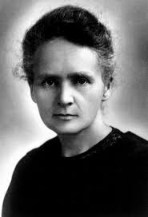
Marie Curie
Elle s’appelle
L’Age de 67 ans morte de cancer
Ses Yeux bruns
Ses Cheveux bruns
Sa Profession est chimiste
Qu’est-ce qu’elle fait?
Découvert le radium
Gagne le Prix Nobel Deux Fois
Invente la terme “radioactivité”
La caractère est sympa, tranquille, réservée, intelligente
Sa Nationalité est Polonaise
Habiter à Paris
Pays-Pologne
Parler-français et polonais
Manger-la tarte à la viande
Aime les voyages de vélo
Aime le fromage
Sa Peau pale
Aime les voyages avec son mari
Son école Paris est Sorbonne
J’admire…?

Slide 11

MOI
L’Age-10 ans
Les yeux noirs
Les cheveux noirs
Sénégalaise
Calme & Sérieuse
Habiter à Dakar
Le foot et danser
École-College Dakar
Troisième niveau
Aimer le poulet, le riz, les cacahuètes
Détester la crime
Naza
MA FAMILLE
Mon frère Demba
Ma sœur Thérèse
Mon père Soldat Amadou 42 ans
Ma mère Ndella 39 ans Femme au foyer
Grand-père 55 ans
Grand-mère 53 ans
Oiseau Wazo 2 ans
Mes Amies: Khady et Astou
Mes Profs: Mme Anta et Mlle Oumou
Mes Voisins: La famille Rama

Slide 12
Warm-up Examples
2-Greet and Speak (Topic-Past Tense)
Have students speak with a partner and find out what they did over the weekend/last night/last week. Then, call on students to report their findings to the class.
3-Find the Fib (find the sentence that is wrong/false)
Marie Antoinette was the only woman who won the Nobel Prize twice
Because of radiation, her documents are dangerous to hold
She discovered the process of x-rays
She was Polish
Her husband was killed by a horse-drawn carriage in Paris

Slide 13
Warm-up Examples
4-Give Your Opinion-Write a debatable statement or question of the day related to the topic on the board and have students work in pairs to discuss and then present their opinions on it.
Should students be put in a track/major while in high school or should they be able to pursue a liberal education with no track?

Slide 14
Warm-up Examples
5-Film Clip
Show a brief film clip and then have students give their reactions to it. The film should relate to the content of that day’s lesson. Variation: Ask each student to write and share a one-line reaction to the clip.
6-Object Story Telling
Bring a few objects (related to topic) to class and tell students a story about them (why you have them, what you use them for, why they are important to you, how you acquired them, etc.) Then, have students work in groups to do the same.

Slide 15
Warm-up Examples
7-Song-Sing a song in the target language and have students identify the message and new vocabulary with a partner.
8-Mood Food (Topic-Food from your country)
Give students 4-5 foods and pair up with a partner. Have them describe their mood with a statement when they eat that food (angry, happy, excited, etc.) Several plastics foods are available to check out from CLS.
9-Describe the Picture-Partners

Slide 16
Warm-up Examples
10-Vocabulary Lists
Write a vocabulary word related to the topic on the board and have students work in teams of 2-3 to write as many related words as possible in one-two minutes. This is a good way to review and introduce vocabulary.
Write “death” on the board.
Related words: Funeral, tomb, cemetery, mass, wake, life expectancy, urn, ashes, casket, coffin, burial, cremation, embalm, eulogy, mortuary, morgue, pallbearer, shroud.

Slide 17

Present & Practice Steps-Furniture and Rooms of the house

Slide 18
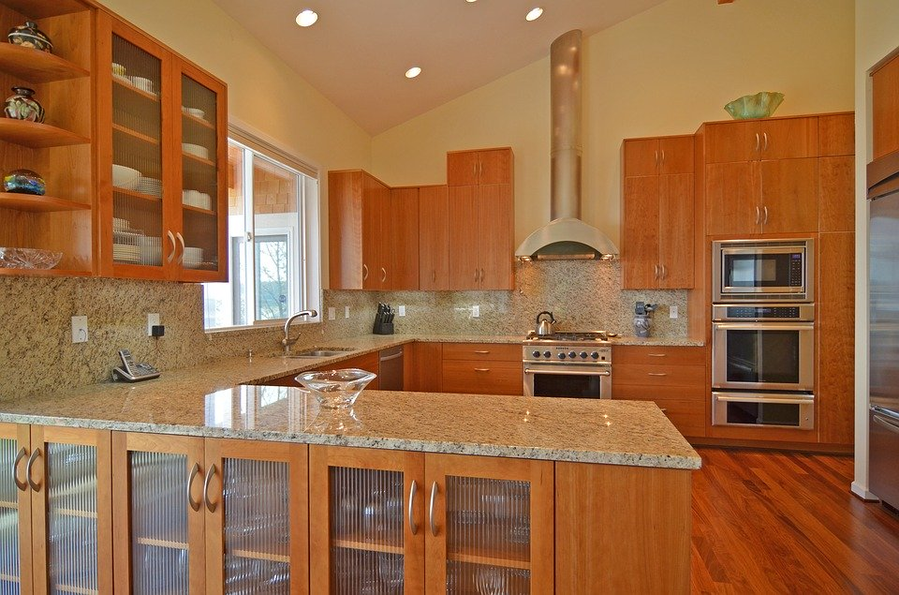

Slide 19
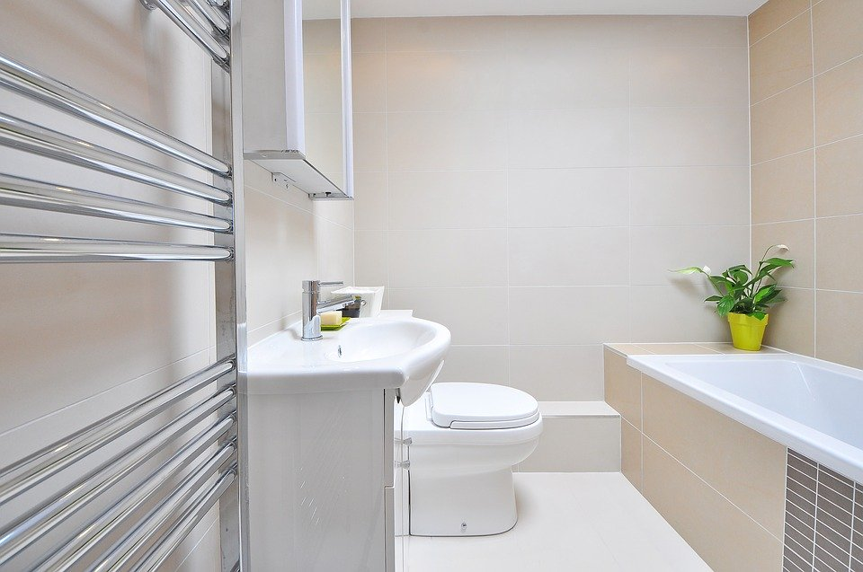

Slide 20
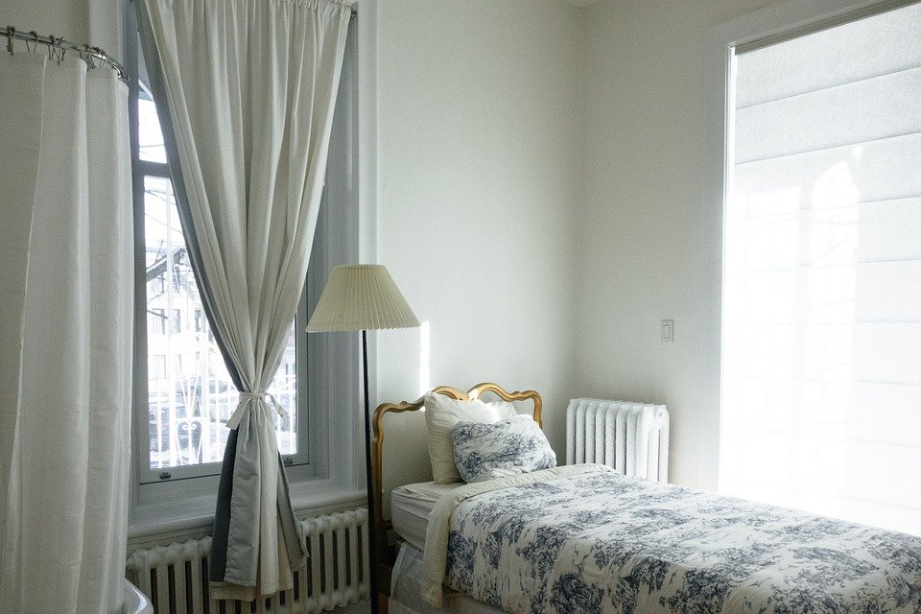

Slide 21
Practice Step-Students pair up with charades guess the furniture items

Slide 22
Practice Step-Students describe to partner what furniture to draw

Slide 23
Product
Products are considered anything that are products from the classroom learning. A product example is a role-play
Role-Plays (Renting an apartment/buying a house)
You want to rent an apartment or buy a house. Talk to the building manager/landlord/real estate agent and describe what you want. Ask at least 5-6 questions to find out everything you need to know (role-plays are good to use for products also).

Slide 24
Wrap-up
1-Top ten things you learned from today (students contribute and this will be the quiz for the next class)
2-Two-team relay (students come to the board to write one thing they learned-two teams)
3-Reflection response of class at the end of class
4-Summary of things learned
5-Five question quiz
6-Kahoot.it

Slide 25


