Slide 1

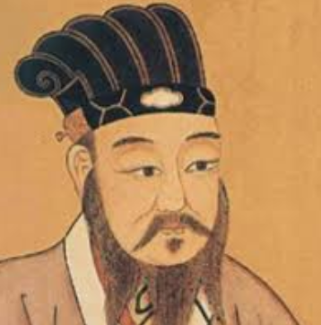
我 是 孔老师 wo shi
Kong laoshi
Confucius

Slide 2
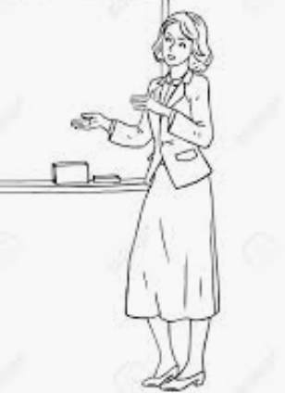

我 是 BYU 的老师 wo shi BYU de laoshi

Slide 3

我 有 三 个 孩子 wo you san ge hai zi

Slide 4
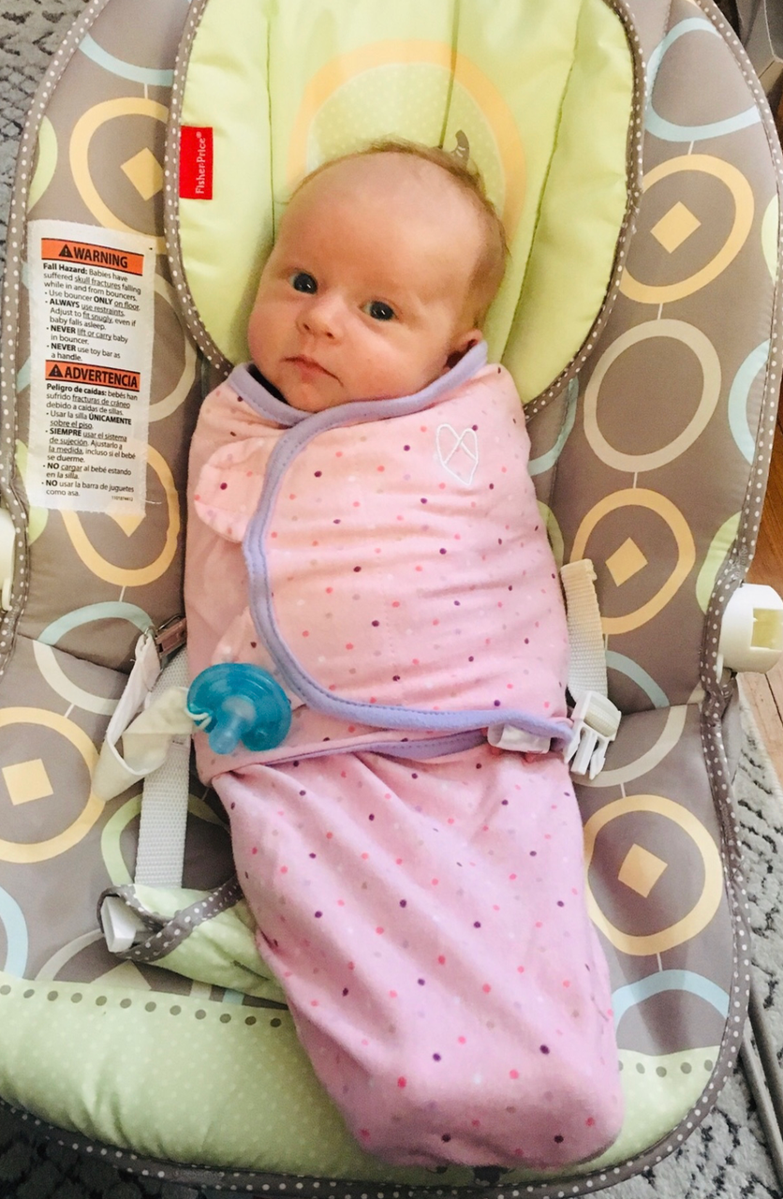

我 有 一 个 孙女 (宝宝） wo you yi ge sun nu.

Slide 5
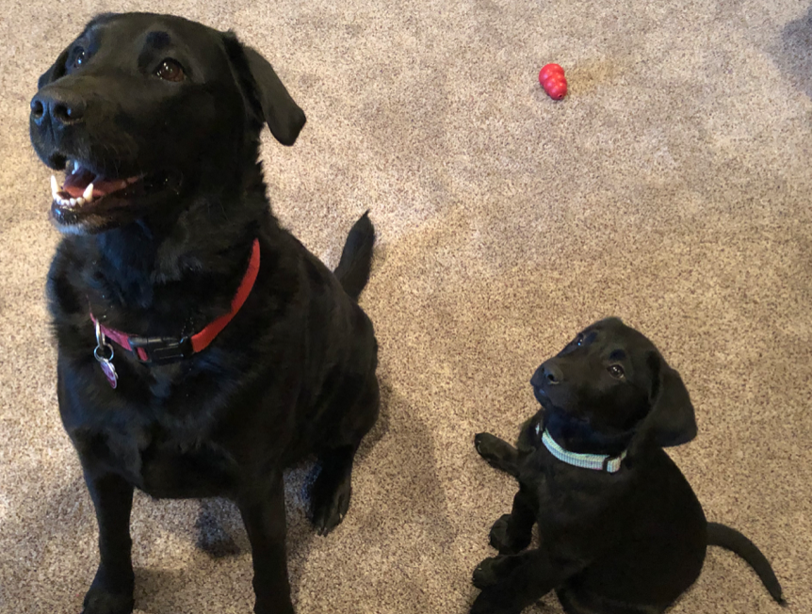
我有 两只狗
一只很大，一只很小

Slide 6
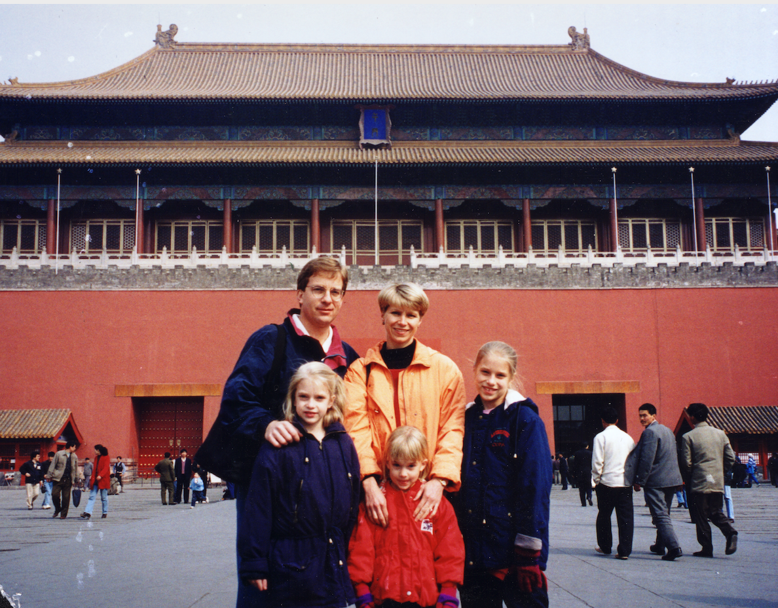
那时候
我们 常常 去 中国。 1993-2001
Wo men yi qian zhu zai China.

Slide 7


我 以前 在 Taiwan 传教 wo yiqian zai Taiwan chuan zhao

Slide 8
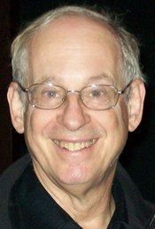
Comprehensible Input
(Stephen Krashen) 1977
Theory of Comprehensible Input
  Students can comprehend input that is slightly above their current level
Direct approach – no translation
Notes:
Naturally acquire language. - how do you do that Experience with Spanish teacher – China (immersion education)
- What I’m going to do in just a minute

Slide 9


xi huan
bu xi huan

Slide 10


xi huan
bu xi huan

Slide 11

我 喜欢 看 书 wo xihuan kan shu.

Slide 12

我喜欢看电影 wo xihuan kan dianying

Slide 13
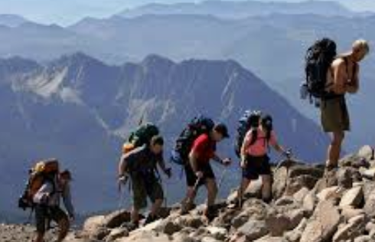
我喜欢爬山 wo xihuan pa shan

Slide 14


我不喜欢做饭 wo bu xihuan zuo fan

Slide 15
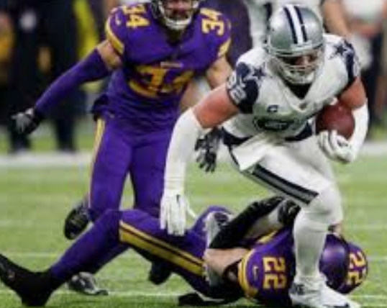
我不喜欢 打足球 wo bu xi huan zu qiu

Slide 16


我不喜欢买东西 wo bu xihuan mai dongxi。
Notes:
Question hierarchy - gestures, yes/no, either/or, Wh (direct/closed) what, who, when, where, Open (Why)

Slide 17
Xihuan / bu xihuan
Ni xihuan _____________ ma?
kan shu
kan dianying
pa shan
zuo fan
mai dongxi
kan zuqiu
B. Wo xihuan/bu xihuan .
kan shu
kan dianying
pa shan
zuo fan
mai dongxi
kan zuqui
FLANG 377
Notes:
Do questions
Students used gestures, made choral responses, and answered questions. These were all ways to keep them engaged.

Slide 18
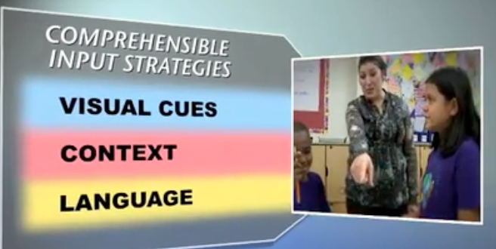
Comprehensible Input
· Taken from Global Village Academy Videos (2013) _
https://www.gvaschools.org/apps/pages/index.jsp?uREC_ID=241578&type=d&pREC_ID=video&showMore=1&titleREC_ID=47777 Met (n.d.). Observing in the Immersion Classrooms Explanatory Text – Mimi Met
Notes:
Give Graphic organizer
write under visuals - what kind of visuals can you use?

Slide 19
Comprehensible Input Strategies
Visuals­­ ­­
Context
Language
Notes:
What types of visuals could you use to give comprehensible input? pairs

Slide 20
Comprehensible Input Strategies
Visuals­­ ­­pictures (PPTs) gestures drawings Realia Multi-media
Context
Language
Notes:
Context?

Slide 21
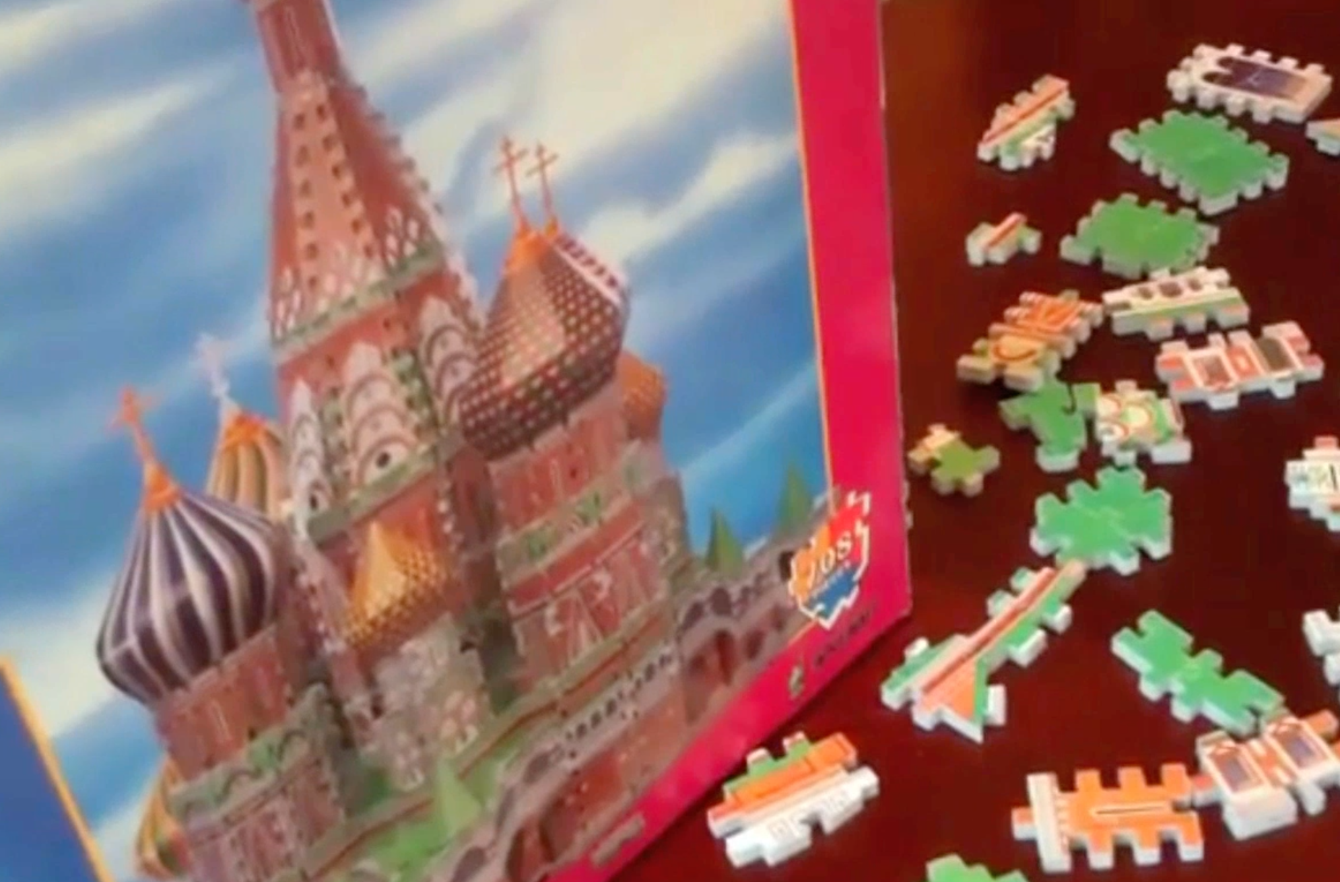
Context – gives clues to the topic
Activate/develop background knowledge –
build on what students already know
Taken from Global Village Academy Videos (2013) _
https://www.gvaschools.org/apps/pages/index.jsp?uREC_ID=241578&type=d&pREC_ID=video&showMore=1&titleREC_ID=47777 Met (n.d.). Observing in the Immersion Classrooms Explanatory Text – Mimi Met
Notes:
Like a jigsaw puzzle – the picture helps you because it gives you context - you see the big picture
Beginners - visuals common topics : clothing, family, food, etc. when more abstract begin by activating what already know and build
consumerism - mall in China (buying and selling)

Slide 22
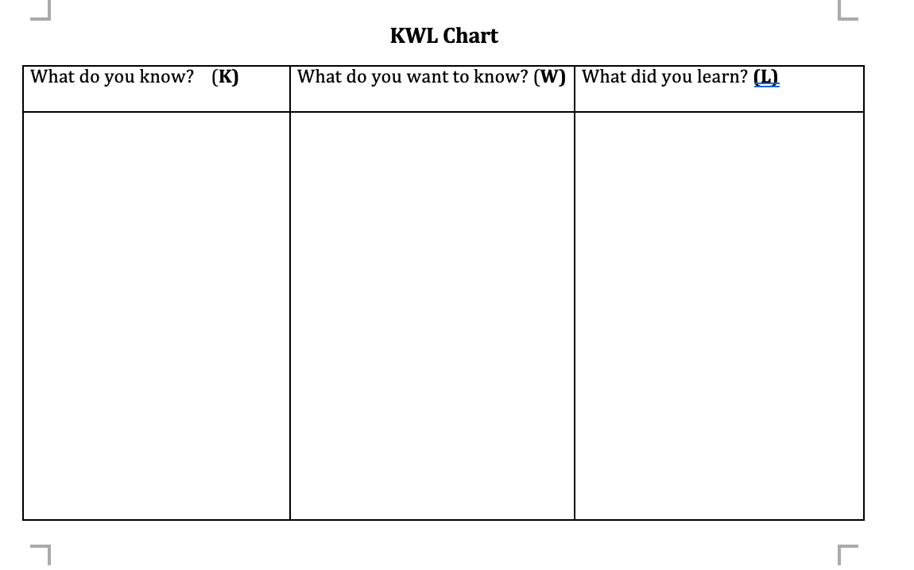
Context – Build on what they know
Notes:
ONe way to do that is to do a KWL chart (different languages)
Discuss w a partner - good for you to know what the students already know

Slide 23
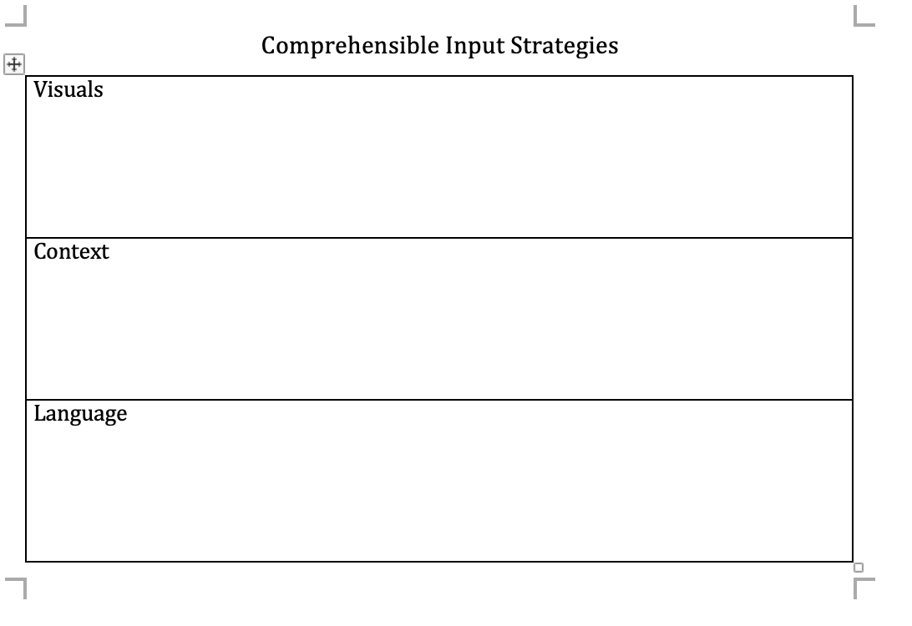
Context - Graphic Organizer
Notes:
Use Graphic Organizers - or advance organizers

Slide 24

Context–Use Sequences/Stories/Personal Experiences
Stories / sequences
  First, second, next, last
      Peru
Notes:
works for beginning and advanced
Advanced level - narrate and describe in all tenses
Ecuador - bed, sheets, breakfast, plate, drink, ma chu pi chu, money, rent

Slide 25
Comprehensible Input Strategies
Visuals­­ ­­pictures (PPTs) gestures drawings Realia Multi-media
Context Develop background knowledge (KWL) Story /Sequences Graphic Organizers Objectives
Language
Notes:
Tell your students your objectives - give them the big picture
Have more language and Get more abstract - (Talk to your neighbor)

Slide 26
Language
How can we use language to give comprehensible input?
Notes:
More abstract concepts - can’t show a picture. How can you use language to improve your comprehensibility?

Slide 27
Comprehensible Input Strategies
Visuals­­ ­­pictures (PPTs) gestures drawings Realia Multi-media
Context Develop background knowledge (KWL) Story /Sequences Graphic Organizers
Language Emphasize new words (tone of voice, rate of speech) Paraphrase – say the same thing in a different way Examples /non-examples Question Hierarchy (gestures, yes/no, either-or, “wh” closed questions, open questions)
Notes:
repeated meaningful exposure
Comprehensible input is language that we make understandable

Slide 28
Question Hierarchy
Gestures
yes/no questions
either/or questions
“wh” questions (closed/direct) what, when, where
open-ended questions (WHY?)
  “Tell me more”
  “What else”
  “Can you add to what _________ said?”
  “Can you summarize _____”
  “Can you paraphrase what ________ said about ________”
Notes:
paraphrase - say in your own words
open ended questions are very important at the advanced level - make sure that you are asking enough of them

Slide 29

Output-Activities Support Comprehensible Input
Think, Pair, Share (turn and talk)
Survey Activity
Information Gap Activity
Role Play
Debate
Fishbowl
Notes:
Need to use the language. - pair shares
Have students come to class knowing the vocabulary - quizlet

Slide 30
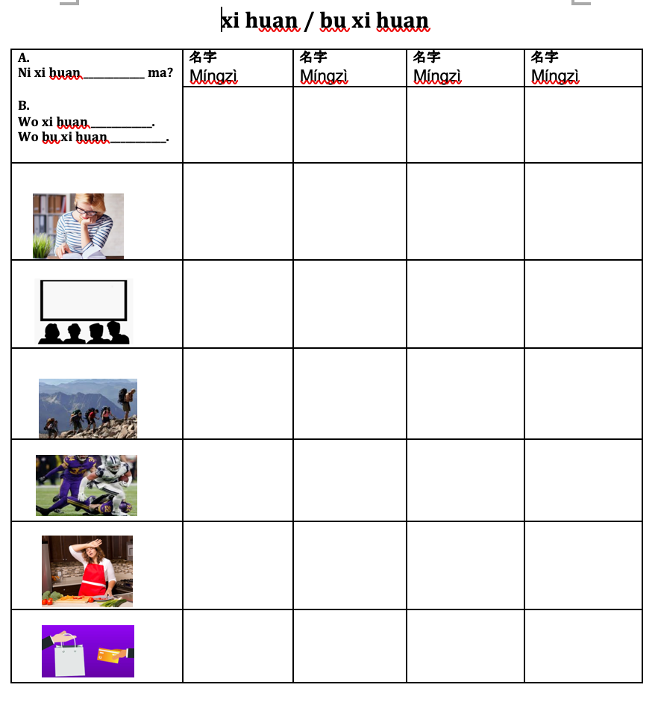
Survey Activity
Notes:
Always model first – don’t need to use English. - Sometimes it’s OK to use English if you have a lot of instructions like in a role play activity
Happy to come to your class and help you

Slide 31
Application (Think, Pair, Share)
What is some input that you want to make comprehensible?
How will you make it comprehensible?
Notes:
Questions

Slide 32
百 Bǎi 100 | 千 Qiān 1,000 | 万 Wàn 10,000
1. 2 4 1 | 2. 5，6 9 0 | 3. 1 1，3 4 5
4. 9 6 0 | 5. 3，3 0 4 | 6. 3 0，5 0 6
7. 3 7 8 | 8. 9， 0 2 4 | 9. 6 6，8 0 2
10. 5 0 6 | 11. 1，8 7 7 | 12. 7 2， 9 1 4
复习 Fùxí

Slide 33
多少人? Duōshǎo rén?
A. Běijīng dàxué 2019 nian yǒu
duōshǎo rén?
B. Běijīng dàxué 2019 nian yǒu
43,555 rén.
A. Běijīng dàxué jīnnián yǒu duōshǎo rén?
B. Běijīng dàxué jīnnián yǒu 43,555 rén.
qiánnián qùnián Jīnnián míngnián hòunián
2017 2018 2019 2020 2021

Slide 34
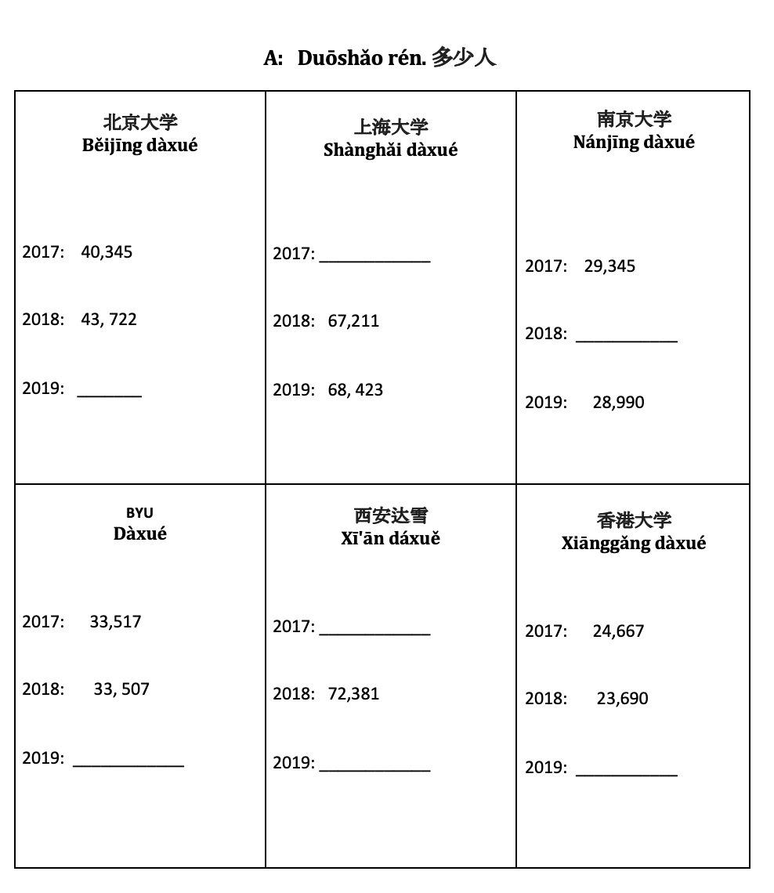
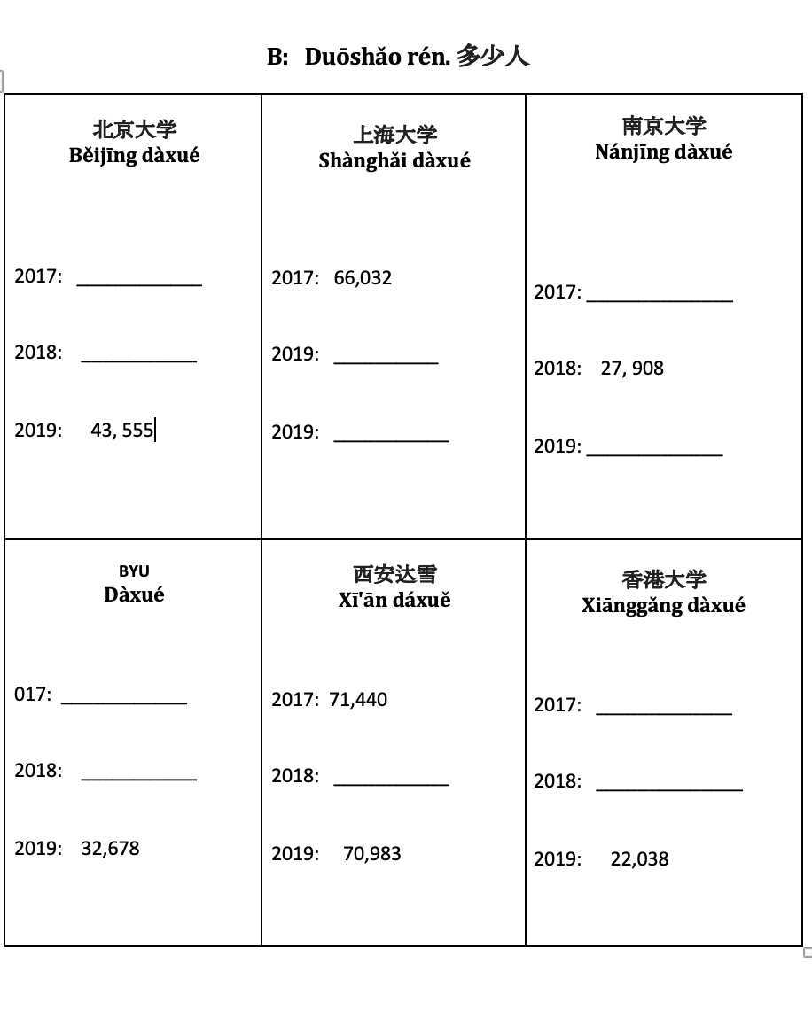
Information – Gap Activity
Notes:
Also Cultural

