Slide 1
Using Authentic materials
Ellen Knell
Readings, videos, Audio (songs)
Taken from - developing classroom materials for less commonly taught languages: Bill Johnston with Louis Janus, Carla working Paper
Notes:
Book. Copy last week materials on activities

Slide 2
Objectives (I Can Statements)
I can…
Choose appropriate authentic materials
Design strategies that use the authentic materials so that my students can increase their understanding of both the target culture and language

Slide 3
Authentic Materials
“Authentic” materials are materials taken from real-life contexts beyond the classroom
Written Materials: | Video: | Audio:
Recipes Brochures Menus Travel Schedules and Maps Travel literature Theatre programs Movie reviews Literature Poems Newspaper headlines/articles Advertisements Receipts/catalogues | Feature films Documentaries News programs Situation comedies Talk shows Television news commercials Music videos | Pop//Folk songs Interviews Audio books or poetry Comedy recordings
Notes:
Def Not made for contrived for a language textbook. At 330 level you should primarily use easy to do in this day of the internet categories

Slide 4
Think – Pair- Share
Share a time when a teacher used authentic materials to teach language and culture
                or
a time that you used authentic materials to teach language and culture
Notes:
How effective was that?

Slide 5
Principles when using authentic materials
Students don’t have to understand every word
Texts are not sacred – they can be altered or played with.
Look at content and meaning first, form (grammar and vocabulary) later.
Use materials as interactively as possible.
Focus on what will stimulate students’ interest (think about the entry into a task or ”hook”).
Vary the task, not just the text
Integrate reading/listening with other skills
Notes:
Came from Johnson and Janus

Slide 6
Written Texts (Beginning Level)
What. kind of company is advertised here?
What is the address and phone number of the company?
Find the Polish names for:
  Australia, Croatia, Egypt, France, Israel, London, Morocco, Paris, Portugal, Spain, Switzerland
What does Wlochy mean?
What do the numbers mean?
Notes:
Use Fala-Tour in Polish cultural info – polish dates are written with the day first, then the month (02.08 = August 2nd.). T use target language but you can have some English. Even for beginners this text works because the tasks I’ve asked are manageable. Vary the task not the text

Slide 7
Techniques for Revisiting Content
The 5 Rs
Report (e.g. Think-pair-share, jigsaw)
Reexamine (e.g., reread/watch w a different goal/purpose)
Repeat (e.g., role-play, summarize. fishbowl activity)
Reformat (e.g., in a graphic organizer)
Review (e.g., for a poster, oral presentation, final project, debate)
Repeated meaningful exposure
Notes:
Form of scaffolding Really helpful for lesson planning types of energy, pros and cons, venn diagram/T-chart - similarities and differences
One of the biggest problems I see is teachers who don’t scaffold or do enough meaningful repeating of concepts and content in meaningful and different ways

Slide 8
Before- During-After reading activities
Pre Activate prior knowledge Make predictions Teach vocabulary or match vocab to pictures Preview text (title, headings, pictures, charts, etc.) | During Cloze exercises (fill in blanks) jumbled sentences to put in order Give questions to answer Graphic organizers Highlight language you want to teach. | After Make up or answer questions Information gap activities Role play and script Rewrite ending Rewrite from a different perspective Give presentation Make poster or brochure Language activities
Notes:
Does anything stand out that you have done before???? Then give handout

Slide 9
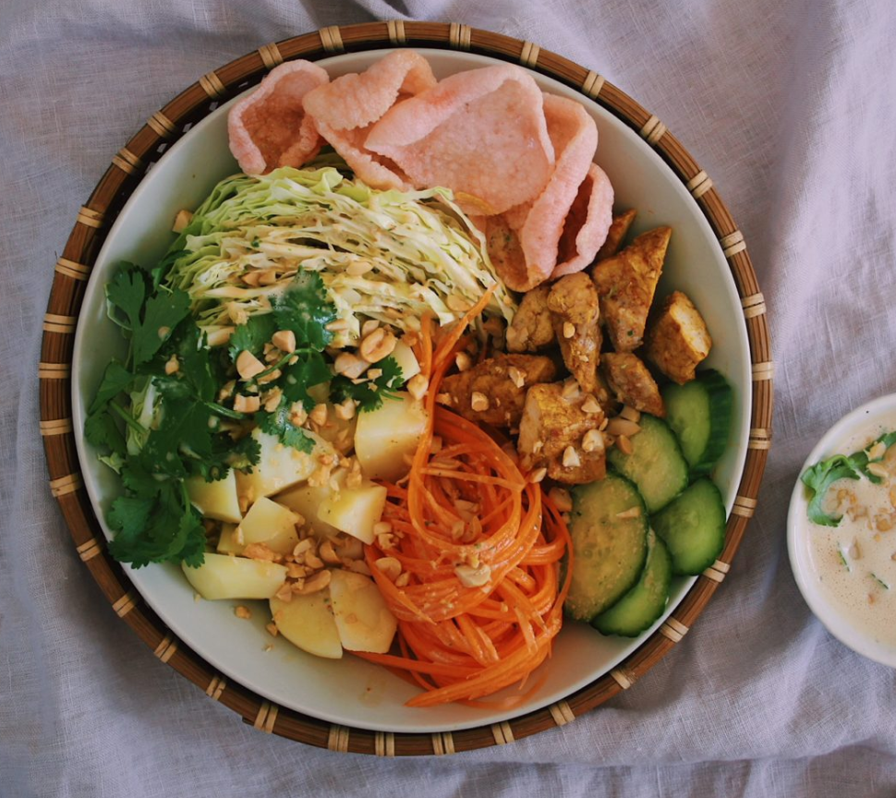
Written Texts (Intermediate Level)
Making Gado-gado. (Indonesian recipe)
  Think-Pair-Share
  What pre reading activities would you do?
  During reading activities?
  Post reading activities?
Notes:
We did beginning reading example now lets look at an intermediate example. Recipe. Show recipe. (pg. 30). What are some pre, during , and post activities??????

Slide 10
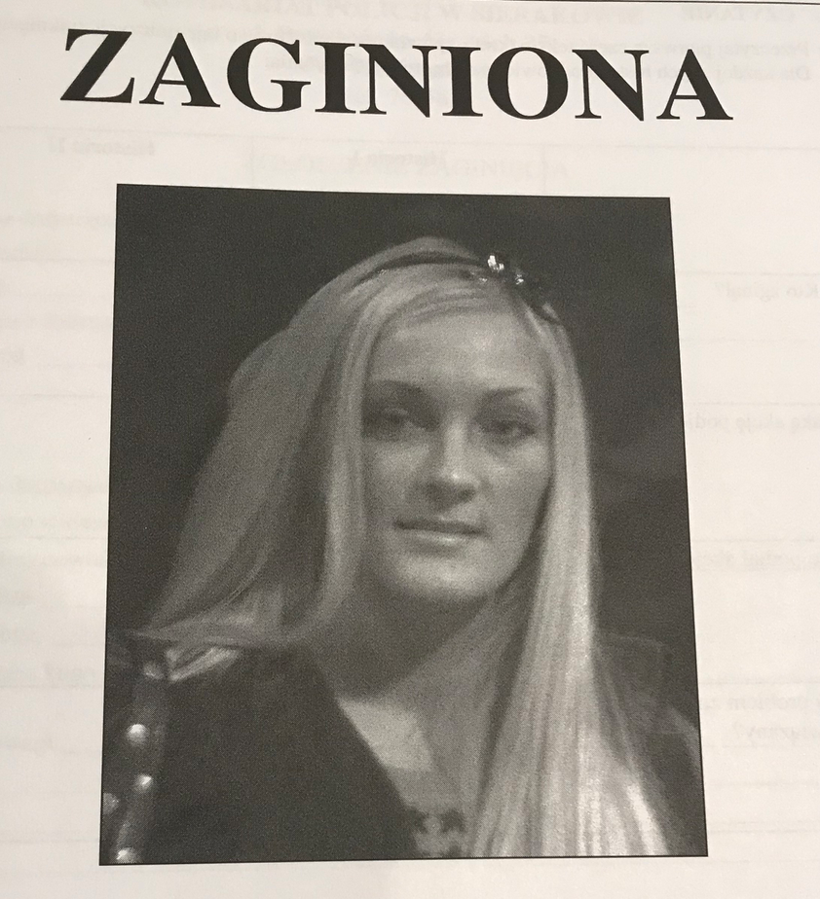
News Article (Intermediate/Advanced)
“Like a Stone Into Water”
  Actual stories of missing persons in Poland
  (Unit on Crime)
  Think-Pair-Share
  What pre reading activities would you do?
  During reading activities?
  Post reading activities?

Slide 11
Written Texts (Intermediate/Advanced)
Like a Stone in Water | First Story | Second Story
Who disappeared?
What action was taken?
Who took this action?
Was the problem solved?
Police Report
Information: (date, descriptions, circumstances)
Chart with Statistics about disappearances
Questions
Language
Verb + complement grammar combinations (Notice, practice, communicative activity)
Follow-up Activity
Students would describe a person who was missing and the last time they say them (Describe how they were dressed and behaving, where they were when lost etc.
Notes:
Show picture in book – Describe reading – what could be some ways to introduce (pre, during, post)
Can do a lot with authentic tests – bring language in

Slide 12
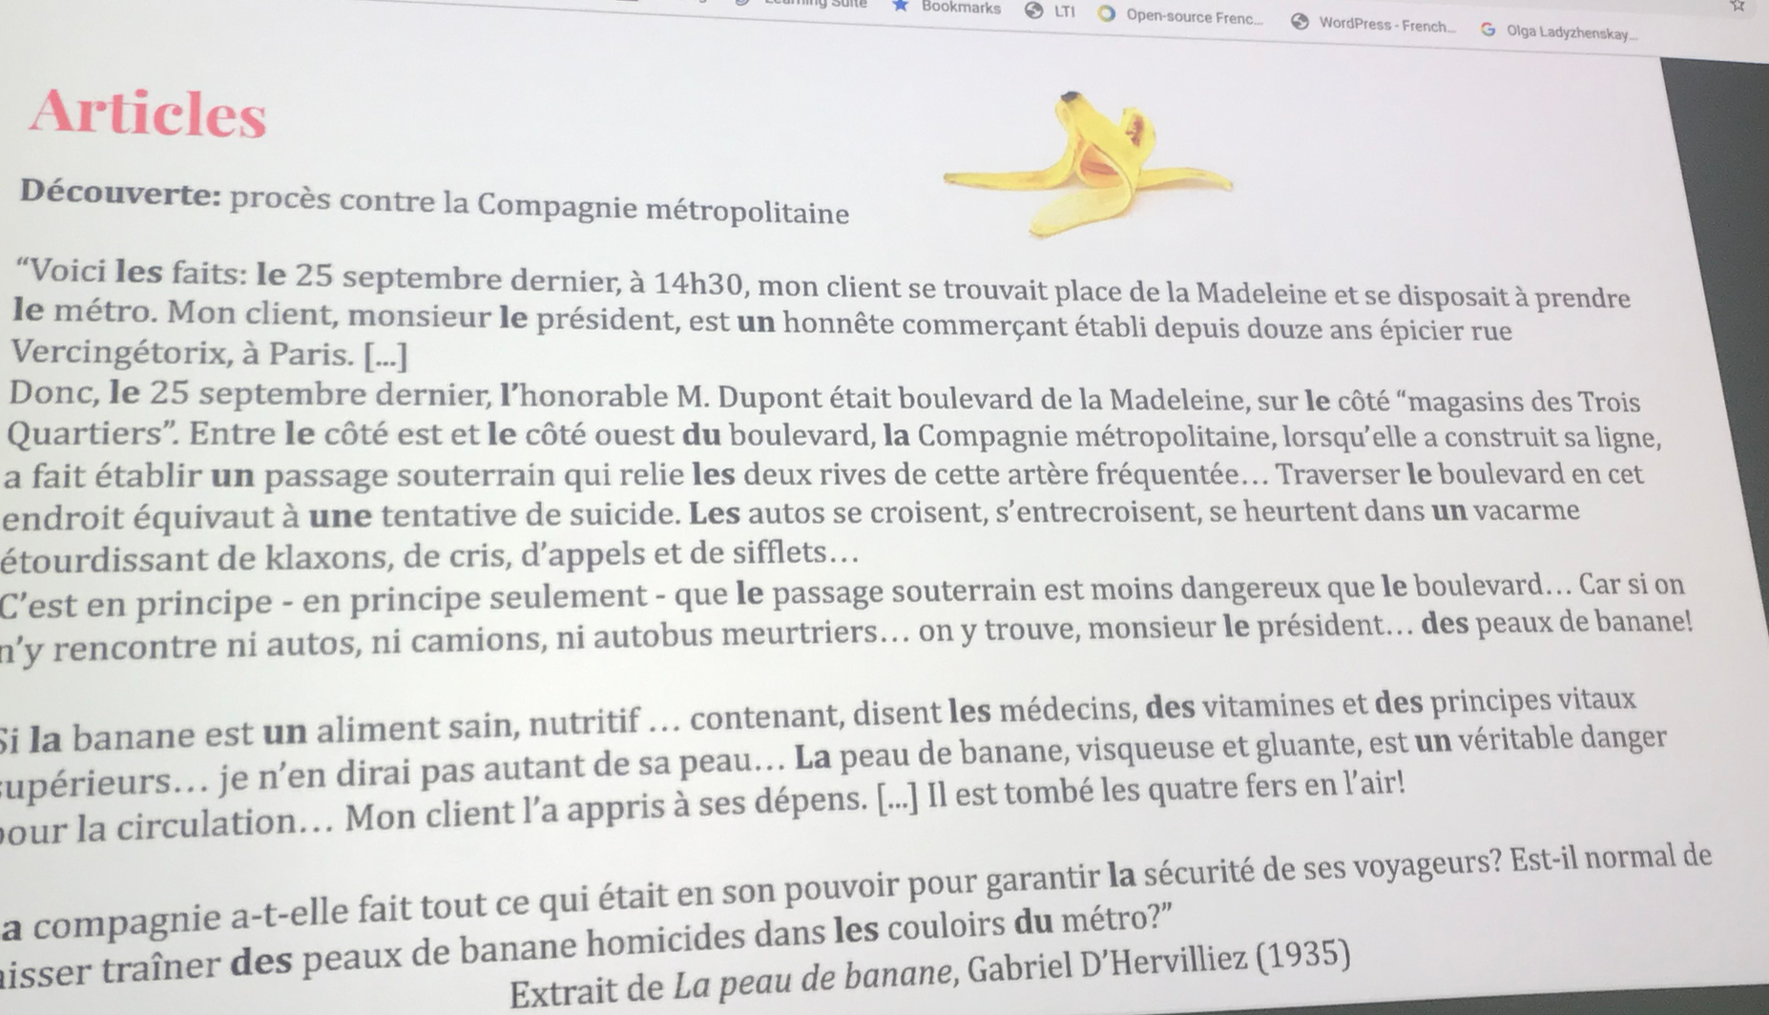
Draw attention to Grammatical features in the reading

Slide 13
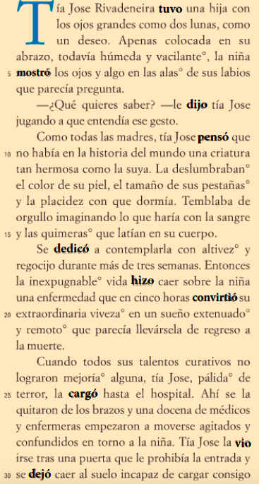
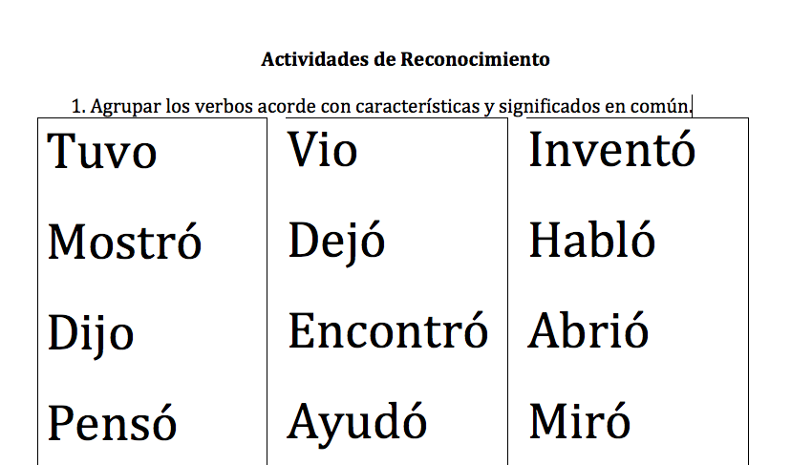
Mujeres de Ojos Grandes p.155 segunda vez
¿Qué significan estas palabras?
Piensan en el significado de las palabras, qué tienen en común?
¿Qué es el patrón de esa forma del verbo?
Notes:
Anthology of stories about women from Mexico

Slide 14
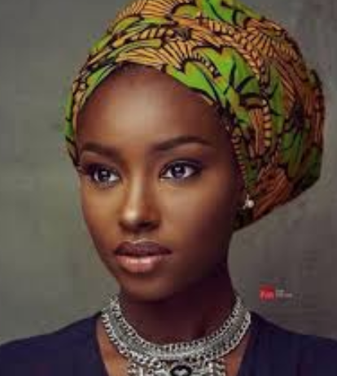
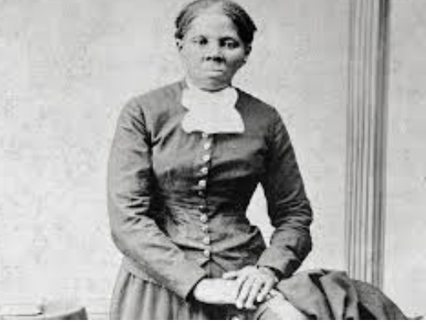
Poems
Beauty – Swahili (Intermediate)
Before: The teacher passes out pictures of celebrities and the class discusses what determines beauty
During
The teacher…
reads the poem twice
solicits information from the students about what they understand so far.
allows time for silent or partner reading and then asks for more information
Questions:
What does the author think about beauty of the face?
How does the author think beauty should be measured?
Vocabulary:
In pairs, look up the meanings of words (pima, ajabu, fai, busara, Johari, sera, tijara).
Is the poetic usage the same as the dictionary meanings?
Discussion: Do you agree with the poet? Why or why not
Notes:
Learn a lot about culture and language from poetry Pg. 40. Talks about the beauty of the face compared to the beauty of character and honor
(Do a T-chart ”beauty of the face vs. beauty of character”. Harriet Tubman

Slide 15
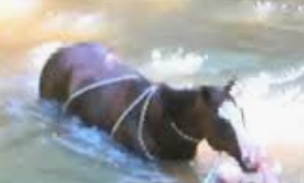
Literature – Aunt Cecylia’s Adventure (Novel)
Give the students the beginning of the story, up to the word “Suddenly.” Also provide the ending: “Afterward she spent three days in bed…”. Students work in pairs to write the rest of the story.
Choral read the story and do a graphic with beginning, middle, and end
Provide jumbled-up sentences which the students then arrange in the correct order.
Write a newspaper article based on the incident.
Write the story from the perspective of the horse.
Rewrite the story according to what you would have done.
Notes:
From a Polish novel. - small chunk These are mostly post reading activities – some pre and during

Slide 16
Songs
Think- Pair- Share
Talk about an experience you have had learning a language while the teacher used a song?
Have you ever used a song to teach your language?

Slide 17
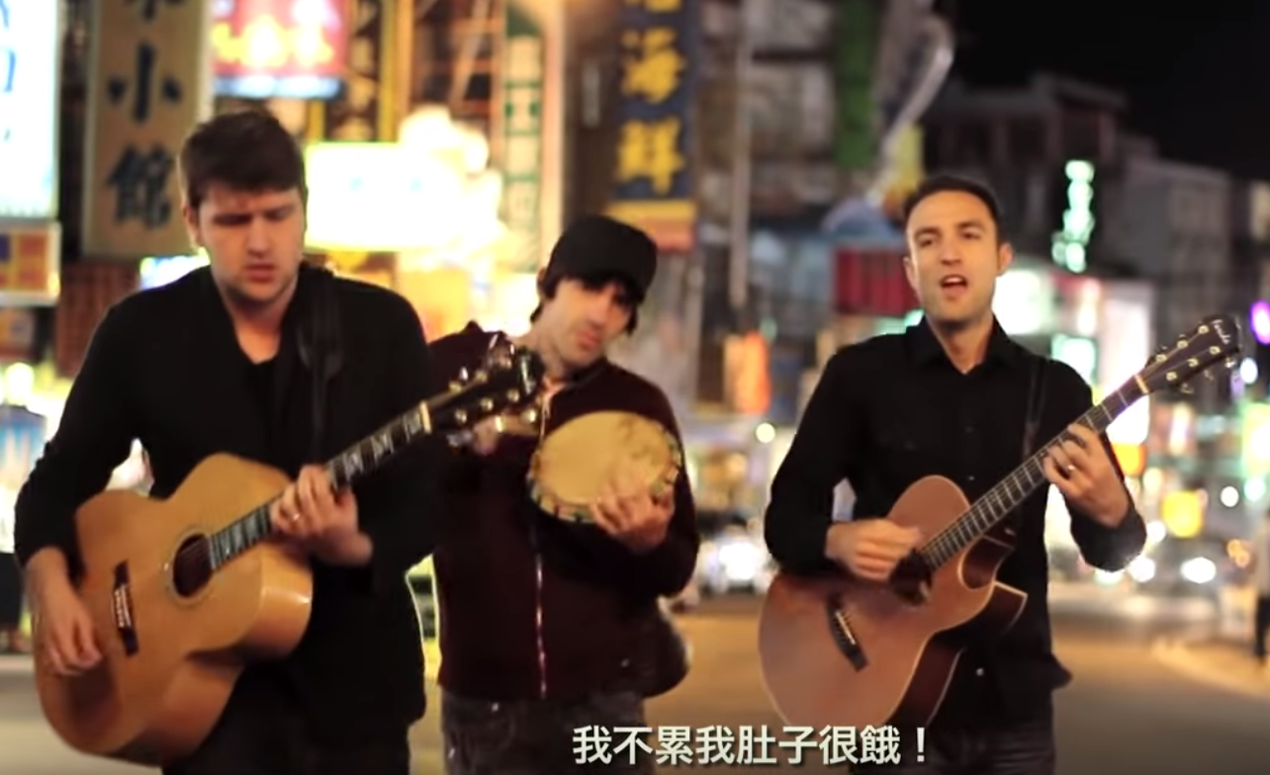
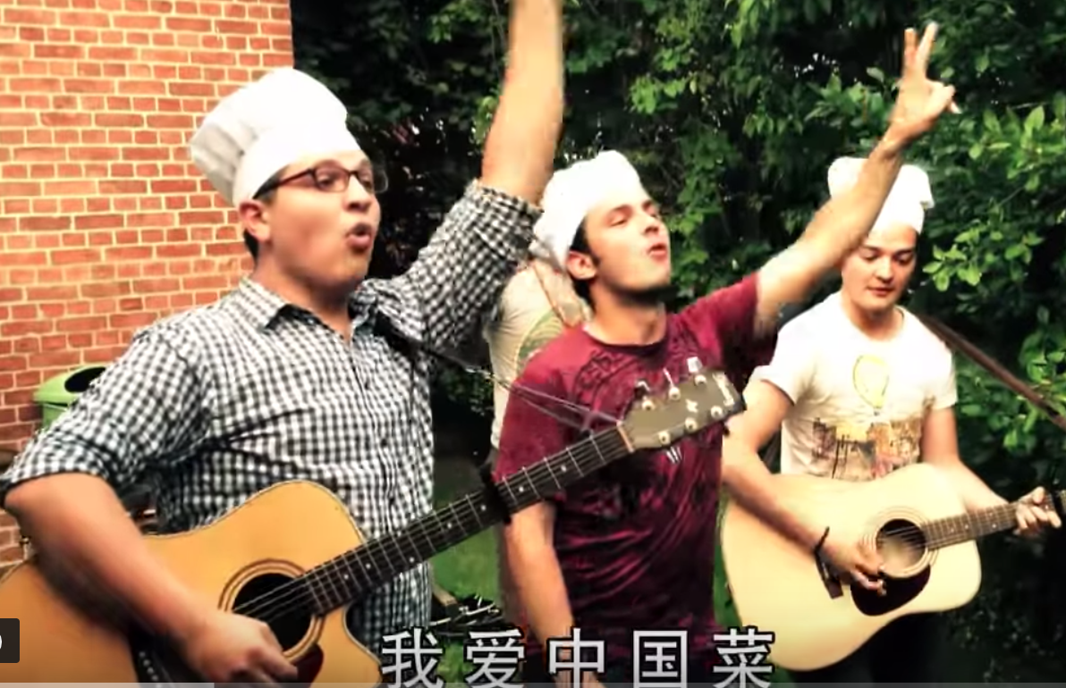
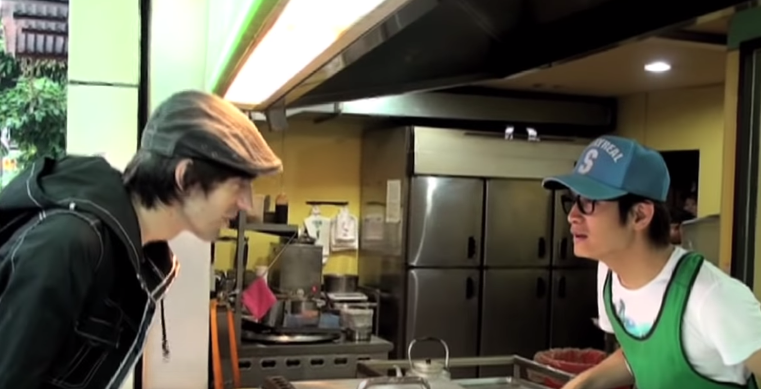
Dui Bu Qi Wo de Zhong wen bu hao
https://www.youtube.com/watch?v=2XTBwvi0h2E&list=TLPQMjIwMTIwMjCsCb1V3dtDpA&index=1
Notes:
Rhythm and rhyme help learn. - motivation learn about culture
Pre. During. Post. Listen and fill in words Sing the song. - make their own music video

Slide 18
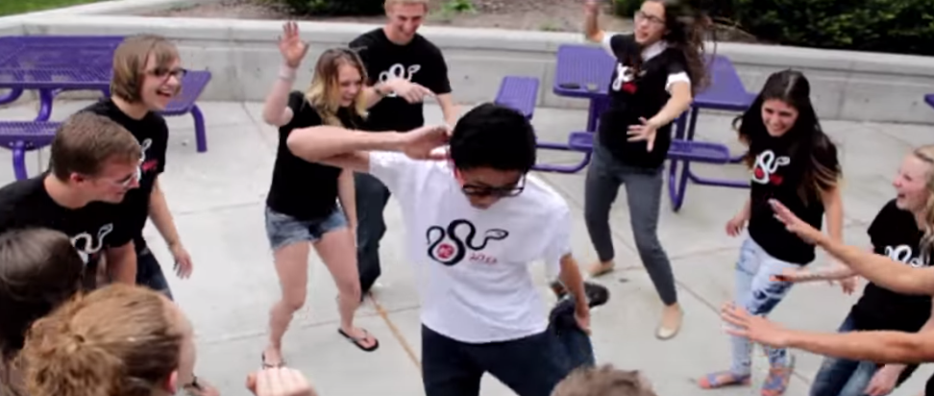
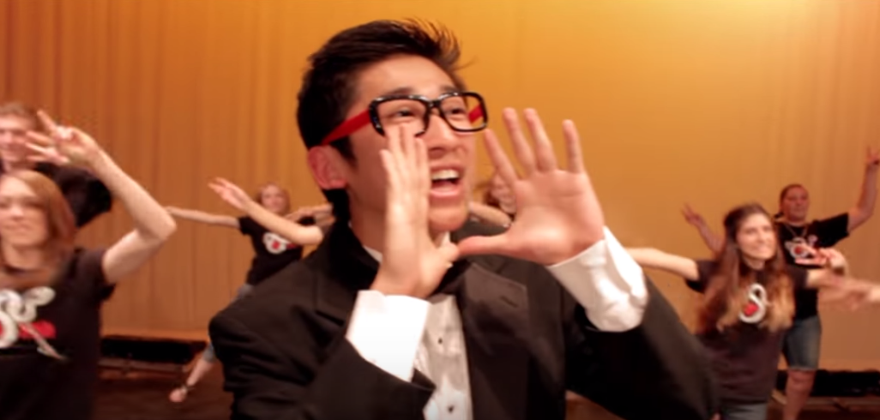

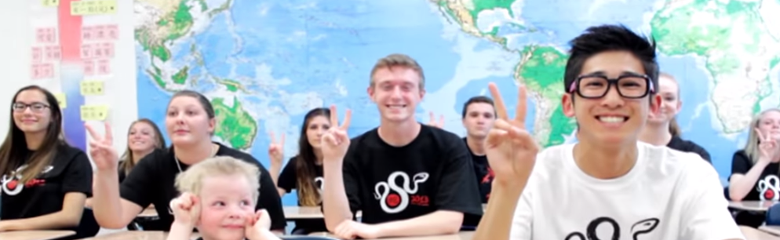
Music Videos
- the 12 Zodiacs

Slide 19
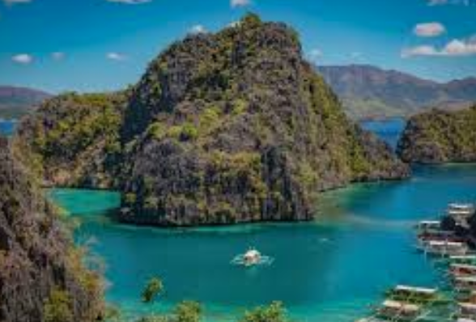
Audio Materials
Songs (pg. 61)
Traveling to the Philippines (Intermediate)
Before listening:
Develop background knowledge: What part of the Philippines have you been to? What places have you heard about where you would like to go? (List the names of the places on the board)
Match flashcards with pictures of food/things to do and match with the corresponding places. Talk about what visitors can do in each place.

Slide 20
Audio Materials
Songs (pg. 61)
Play the song then distribute the written stanzas of the song.
During listening:
While listening, fill in the blanks.
While watching the video, complete the phrase/sentence on the left with the correct word/phrases on the right
Identify words. From the song that are verbs and categorize according to affixes (-um, -mag, -ma)
After listening:
Arrange lines in sequence
Each group is given a map and the lyrics of the song and locates the places mentioned in the song on the map.
Each group lists five new words or expressions
Each group makes a travel brochure or poster

Slide 21
Video Materials
Think- Pair- Share
Talk about an experience you have had learning a language while the teacher used a video?
Have you ever used a video to teach your language?

Slide 22
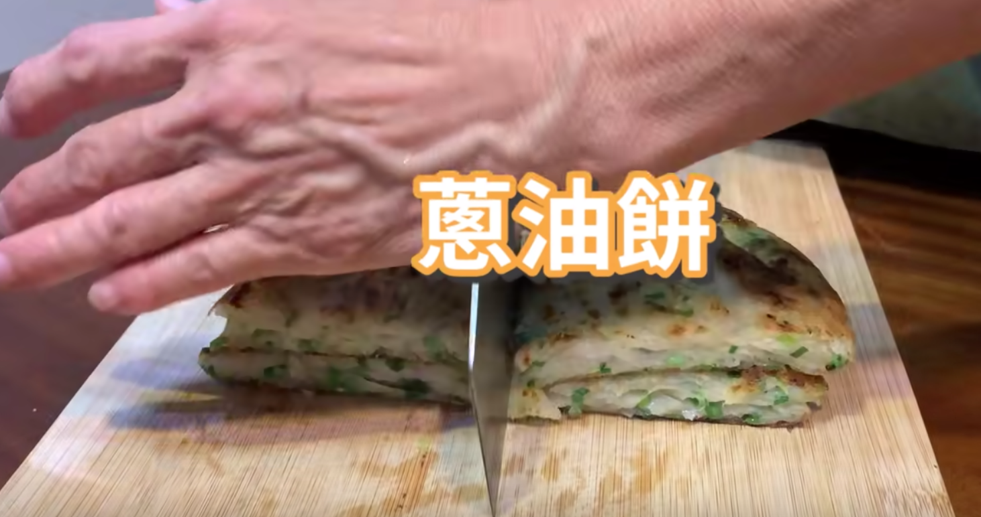
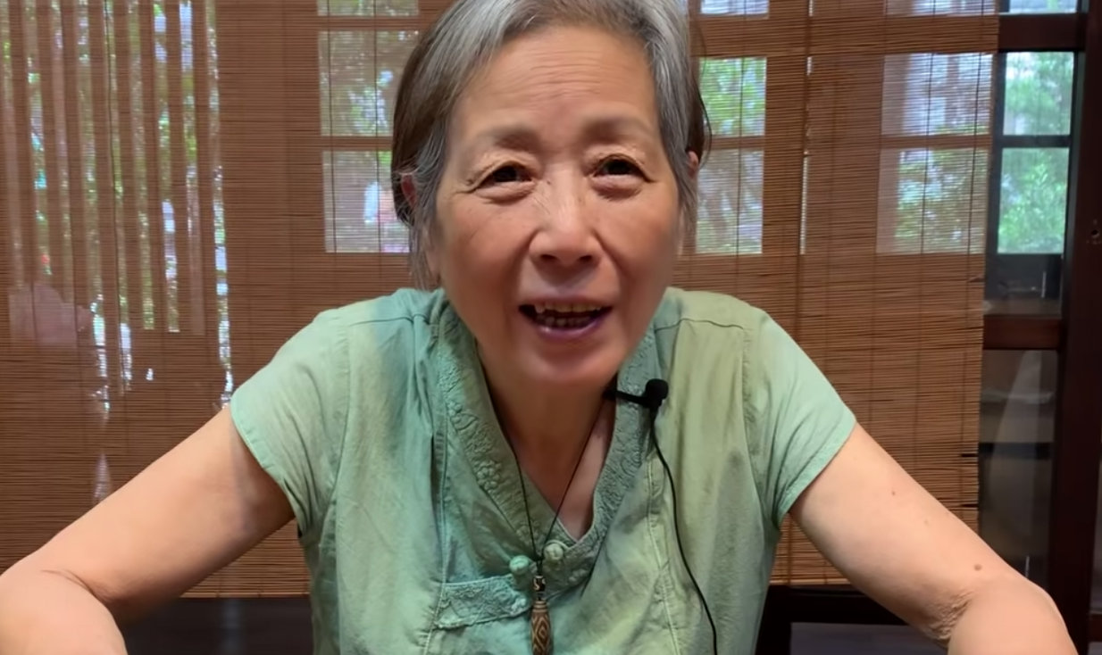
Video: making onion Pancakes https://www.youtube.com/watch?v=0Qk76A7D-r8

Slide 23
Intensive video Viewing (1-4 minutes)
Pre:
The point of entry – hook them
  Picture, title, sentence, video still
  “I knew they’d come for me. I knew I had no escape.”
    Who might have said this sentence, to whom, and under what circumstances
Give students only those vocabulary words absolutely essential to complete the first task
Sound Off
  Turn the sound off and watch only the images. Have the students predict what the video will be about.
Vision Off
  Cover up the screen and have the students listen. Have them predict what the characters look like, where the scene takes place and what actions are going on.
Split Screen
  Cover up half of the screen
Notes:
Use just a few minutes 1-3. Keep it short.

Slide 24
Intensive video Viewing
During:
Select a key scene and have a cloze (gap-filling activity)
Spotting your sentence
Sequencing sentences according to plot
Building up backwards
Using Transcripts
Notes:
Building up backwards – start at a point in the middle and then have the students watch to see how everyone got there

Slide 25
Intensive video Viewing
Post:
Working with language
Acting out a scene and writing a script
Making their own follow-up video
  New ending
  Perspective from a different character
Write a simple summary of the video
Write a critique
Notes:
Show two examples of a video used with beginners – page 89 vx. Intermediate. Learners (news report) pg. 87

Slide 26
Application:
Think about a lesson you want to teach.
  Decide on an authentic material (reading text, video, song, etc.)
  How will you use the materials? How will you teach the language and content?
Notes:
Keep it simple

