Slide 1
Top 10 Ideas for teaching Culture
Products, practices, perspectives
Dave Nielsen

Slide 2
Our workshop goal
4 | Teachers will not only be able to define and understand products, practices and perspectives in the World Languages classroom and apply this knowledge to their lesson plans/everyday classroom culture but will also serve as resources to their peers for implementing the 3 P’s.
3 | Goal: Teachers will be able to define and understand products, practices and perspectives in the World Languages classroom and apply this knowledge to their lesson plans/everyday classroom culture.
2 | Teachers will be able to define, understand products, practices and perspectives to the World Languages classroom.
1 | Teachers are able to define products, practices and perspectives to the World Languages classroom.

Slide 3
Model for Exploring Culture
Three Types:
Products
Practices
perspectives
Products (WHAT):
Both tangible and intangible creations of a culture-they reflect a culture’s beliefs & perspectives
Tangible EXamples:
Paintings, cathedrals, toys, dress
INTangible Examples:
Music, dance, language

Slide 4
Model for Exploring Culture
Three Types:
Products
Practices
perspectives
Practices (HOW):
Patterns of social behaviors or interactions accepted by society
Rites of passage:
Quinceanera, bar mitzvah, baptism, leaving home
Birth death wedding practices:
Tahitian placenta, Funeral customs in Cambodia, croquembouche bride & groom, ceremonial practices
traditions:
Holiday celebrations, Birthdays, food

Slide 5
Model for Exploring Culture
Three Types:
Products
Practices
perspectives
Perspectives (WHY):
Culture’s view of the world including attitudes, values, ideas, and meanings
EXamples:
Youth valued over age/vice versa
Health care
Bigger is better
Value of conserving
Importance of family

Slide 6
La Pharmacie à Paris
Produits, Practiques, Perspectives
Monsieur Nielsen

Slide 7

Le Pharmacien
A pharmacist is recognized like a doctor in France. I knew that a pharmacy is well known with a green cross. There are several pharmacies-one on every corner.

Slide 8

Un soir, je suis allé à la pharmace pour acheter du poudre pour mes pieds. Je suis allé à la pharmacie parce que le pharmacien est comme un docteur en France.

Slide 9
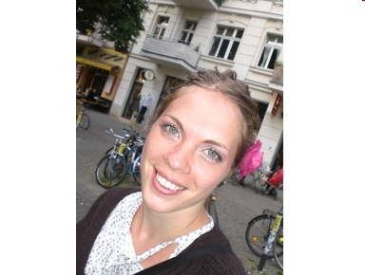
La Jeune Fille
Puis, une jeune femme est entrée la pharmacie et elle nous a entendu. Elle a dit, "Ah, vous avez besoin du TALC"! J'ai dit, OUI, DU TALC.

Slide 10
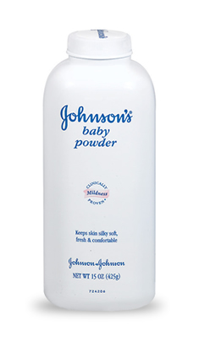
Voici le poudre de bébé

Slide 11

J'ai acheté du talc et j'ai regardé sur le bocal. Il a dit "POUDRE"! Oh là là!!!

Slide 12
Questions
What were the products?
What were the practices?
What were the perspectives?

Slide 13
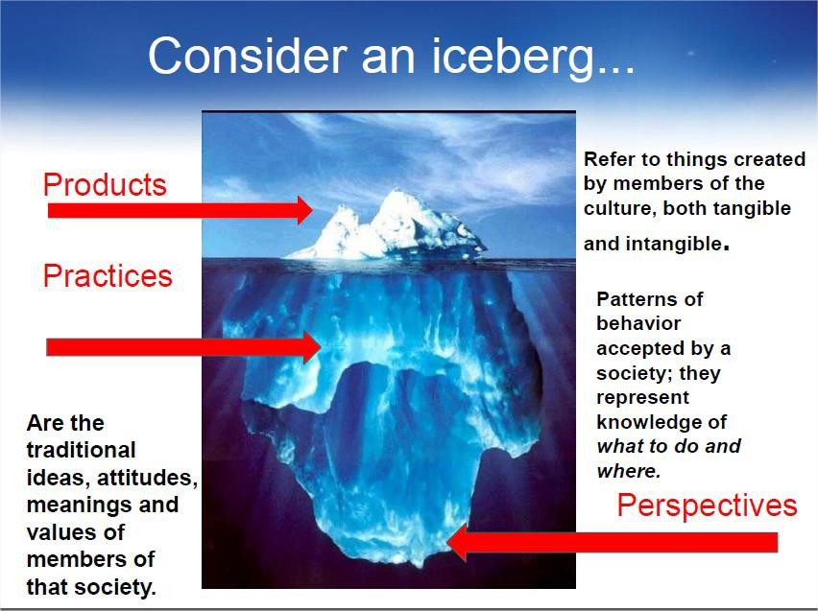

Slide 14
Perspectives in France
Invisible Culture
Pharmacists
  French people trust pharmacists because they are trained to help and give advice.

Slide 15
Examples of the relationship of the three
In the U.S., youth has traditionally been valued more than old age. As a result, products that purport to prolong youth and vitality (e.g., face creams, high fiber breakfast cereals, and fitness equipment) have become an integral part of our culture. At the same time, Things that are perceived as prolonging youth and health are encouraged: school children have physical education to promote physical exercise; many invest in running shoes or join a fitness club; some take extreme measures to look younger and have plastic surgery or wear clothes associated with a younger set.

Slide 16
Questions
What were the products?
What were the practices?
What were the perspectives?
What was the relationship among the three?

Slide 17
Examples of the relationship of the three
In France, bread is considered a fundamental part of every meal. Fresh, long baguette-type loaves of bread are baked and sold daily in Boulangeries. At the table, people break off (rather than slice) pieces of bread from the long loaves and often set the uneaten bread on the kitchen counter to be eaten the next morning as “French bread” (LOST BREAD). Butter isn’t served with the bread. IN France, people are considered like French bread, hard to get to know on the outside but soft and a friend for life when you get to know them.

Slide 18
Questions
What were the products?
What were the practices?
What were the perspectives?
What was the relationship among the three?

Slide 19
THINK/WRITE/PAIR/SHARE
Think of a product, practice, and perspective for Birth, Death, Weddings for your native country
how this is similar or different from the United States?
Share with a partner and then choose one to share with the group

Slide 22
Compare/Contrast Essay
Compare/Contrast Famous People
Directions: Write an essay that describes what (native famous person) did that was noteworthy. Then compare and contrast that person with someone else in history who made a difference in the world. What were the differences and similarities between them? How would the world be different today if this person (along with their inventions/discoveries/contributions) had never lived. Tell why you think this person was a genius or not. Were they incredibly gifted, talented, or intelligent. Compare their contributions to society. Compared to curing cancer, what rating would you give them?
Historical figures that could be used include Mahatma Gandhi, Nelson Mandela, Joan of Arc, Martin Luther King, Thomas Becket, Joseph Smith, Nathan Hale, Socrates, and several others.

Slide 23
Student Class Presentation Rubric

Slide 24
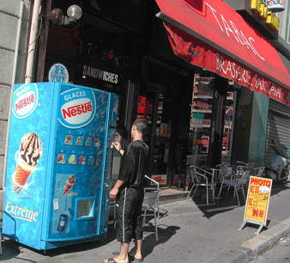

Using Images
Invisible Culture

Slide 25
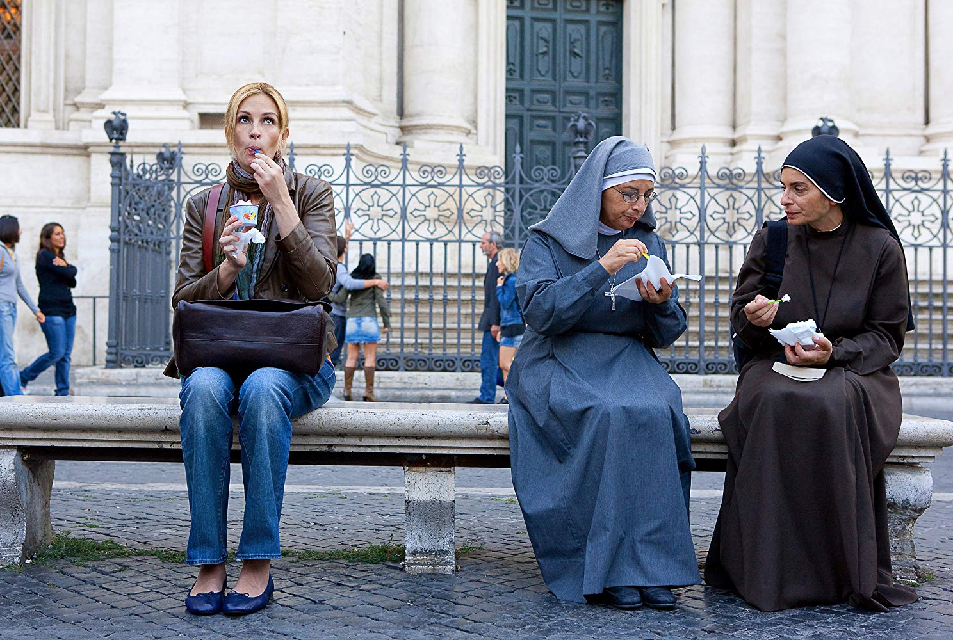

Slide 26
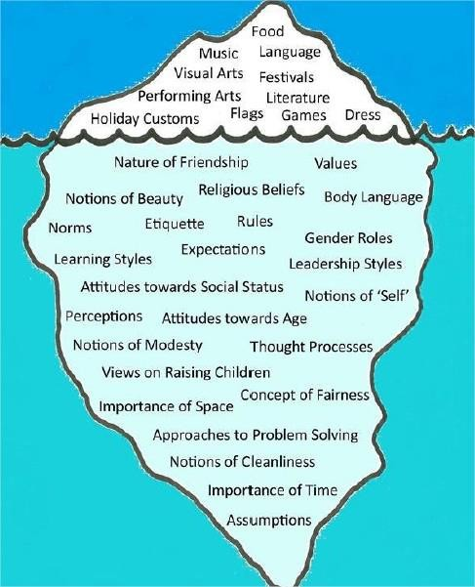
INVISIBLE CULTURE
Examples of types of invisible culture are belief systems, values and unspoken practices that are accepted in a society.

Slide 27
Perspectives in France
Invisible Culture
Eating in France
French people “always” sit down to eat because they want to focus on their food and those with whom they eat without distractions. When asked “Why?” a French professor said “That’s just the way we do it.”

Slide 28
Native Speakers
During the semester, spend _____ minutes talking to a native speaker. This could be done online through any video chat/call platform that works best for you. You may choose a topic from our class units as the subject of your conversation.
After conversing with a native speaker, post a short paragraph about what you have learned for that week on the Discussion Board on Learning Suite

Slide 29
Cultural food day
Reserve the FLAC in JFSB B003 to host a cultural food day. The flac has a kitchen, fridge, oven, microwave, sink, utensils, lounge with chairs, tables, and a big screen tv.
Phone # is 801 422-7103

Slide 30
Field Trips/Experiential education
Examples include students attending cultural events sponsored by the BYU Museum of Peoples and Cultures, International Cinema films @ 250 KMBL, PowWows, Community heritage events, cultural symposiums, firesides. These events should be cleared through CLS. If they are held outside of class time, they cannot be required assignments. If they are during class time, students should be given transportation options.

Slide 31
Perspectives of TIME
Invisible Culture
Time
How different cultures view time.
  Linear-Active cultures (fixed schedules): US, UK, Switzerland, Germany, Austria, Norway.
  Multi-Active cultures (flexible schedules): Spain, Italy, Brazil, Chile, Saudi Arabia, Polynesian cultures
  Reactive cultures (flexible schedules) : China, Vietnam, Japan, Korea, Thailand

Slide 32
Somewhere in time-INVISIBLE
WHEN YOU SHOULD FORGET THE WATCH
let's imagine an Indian partner that’s missed several deadlines with its European client. The European manager scheduled a call and during the conversation cited the agreed-to delivery dates. He demanded an explanation and threatened to impose contractually agreed-upon penalties.
The Indian partner was offended at being called to task and even more insulted at the threat of penalties. The call ended poorly, and a critical manufacturing partnership began to unravel.
What’s Invisible?
The value of time may seem obvious, but cultural attitudes about time may differ below the surface. For example, many people from Buddhist and Hindu cultures view reincarnation as an integral part of their culture. Seeing time as limitless, they place more value on other aspects of life, such as relationships.
The Takeaway
The European manager should have known that his Indian partner’s attitude toward time would impact the work schedule. He should have planned a meeting in advance to discuss how missed deadlines could sidetrack their project and their relationship.

Slide 33
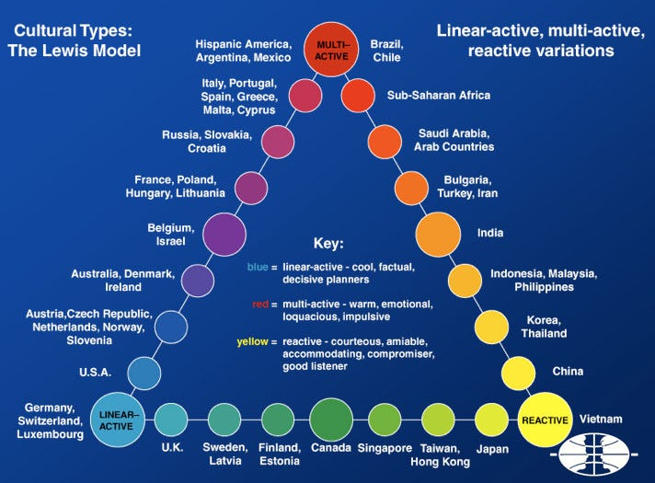

Slide 34
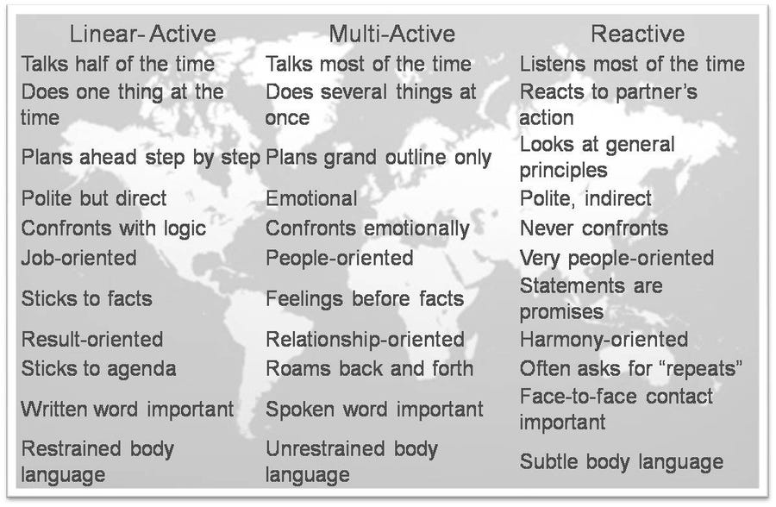
Which one represents your country/culture?

Slide 35
QUESTIONS?

