Slide 1
Introduction to the ACTFL Proficiency Scale
Troy L. Cox, PhD
Associate Director, Center for Language Studies

Slide 2
Introduction: Part 1
Stand up (take your phone with you)
Get in a circle in alphabetical order of the city you are from.
You have 30 seconds.
Timer

Slide 3
Introduction: Part 2
Get in small groups (3-4) and find out what phone apps are used most frequently.
What do people typically do with their phone on a daily basis?
You have one minute to discuss.
Timer 1

Slide 4
Introduction: Part 3
Take out your smartphone and find a photo.
Get into pairs and tell your partner the story behind the photo:
  Setting
  Sequence of Events Leading Up to Photo
  What Happened Afterward
You each have one minute
Timer 1
Timer 2

Slide 5
Introduction: Part 4
Find a different partner and discuss the following:
The relative ease with which we can take an indefinite number of photos can be both a blessing and a curse. While it is now easy to “capture moments” that would have heretofore been impossible or impractical in times past, many find they have so many photos that storing and curating them is now the impossibility.
Has the advent of easily accessible photography helped or hindered us as a society?
What unintended consequences have arisen and how might they be mitigated?
You have two minutes to explore this topic together
Timer

Slide 6
ACTFL Levels are…
A hierarchal list of Functions that are typically accomplished in at the intersection of different levels of
  Accuracy Expectations
  Content/Context
  Text type
Aligned FACTs indicate a major level

Slide 7
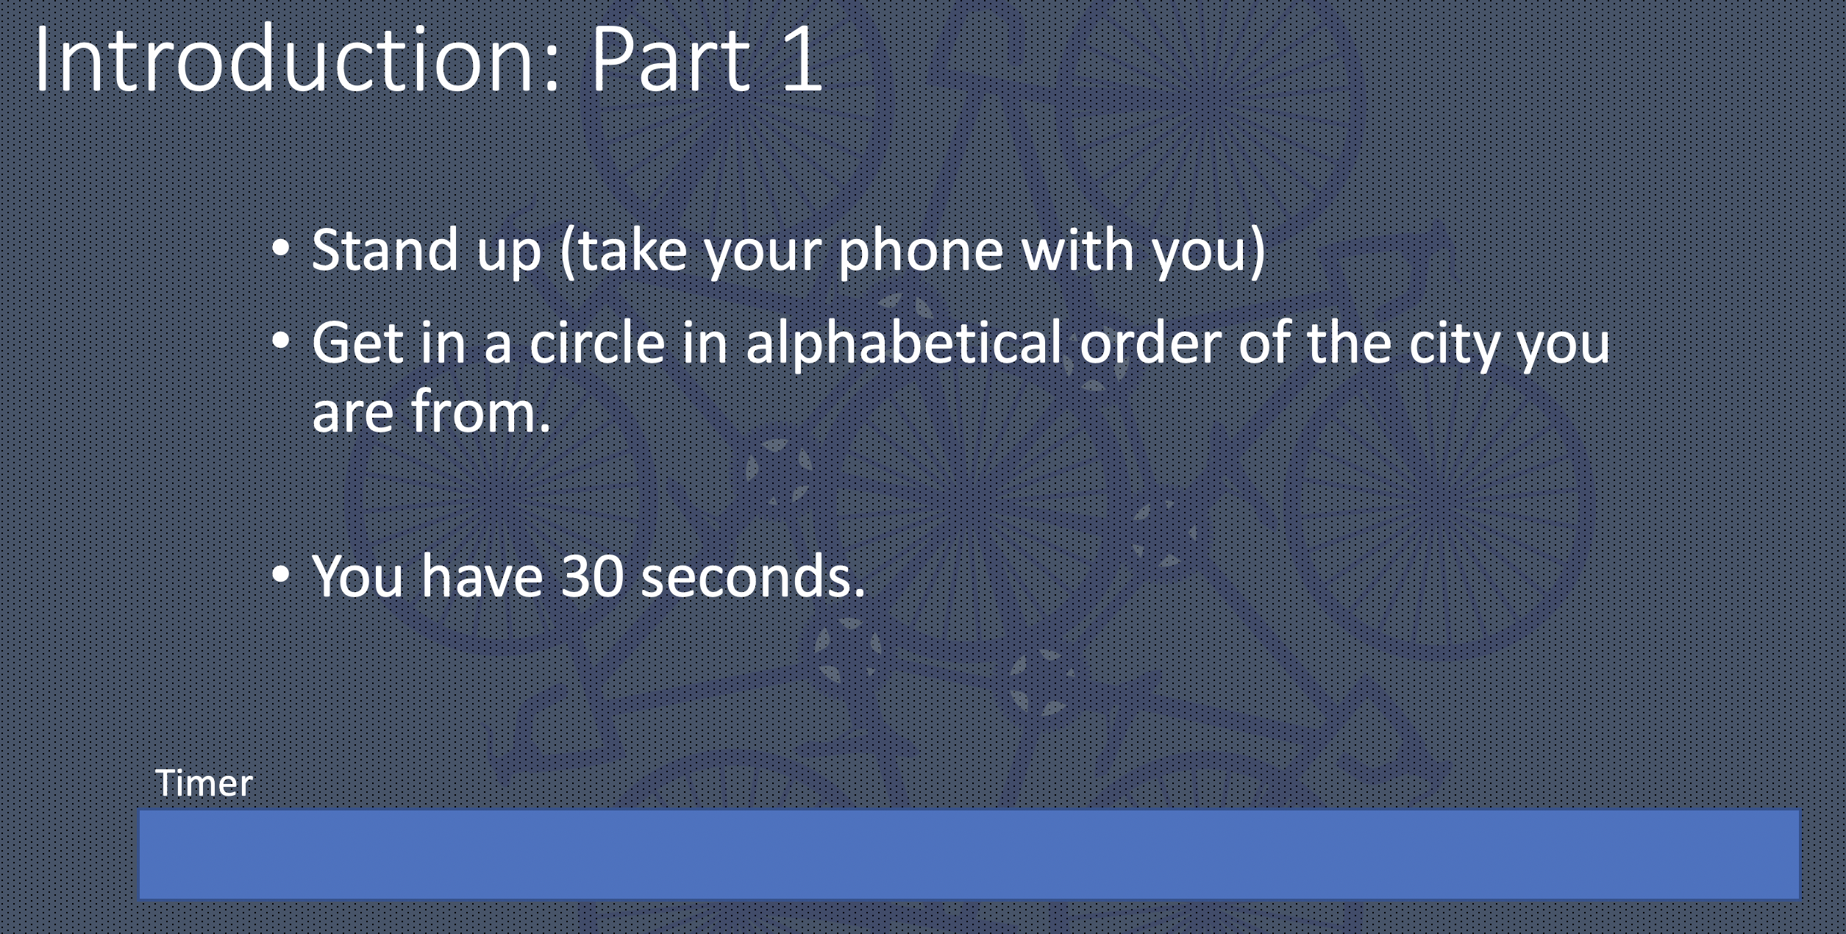
Novice
Function: Can communicate minimally with formulaic and rote utterances, lists and phrases
Accuracy Expectation:
Content:
Text Type:
What are the minimum linguistic features needed to be successful?

Slide 8
Novice
Function: Can communicate minimally with formulaic and rote utterances, lists and phrases
Accuracy Expectation: Can be understood by VERY sympathetic listener
Content: Self
Text Type: Words and phrases

Slide 9
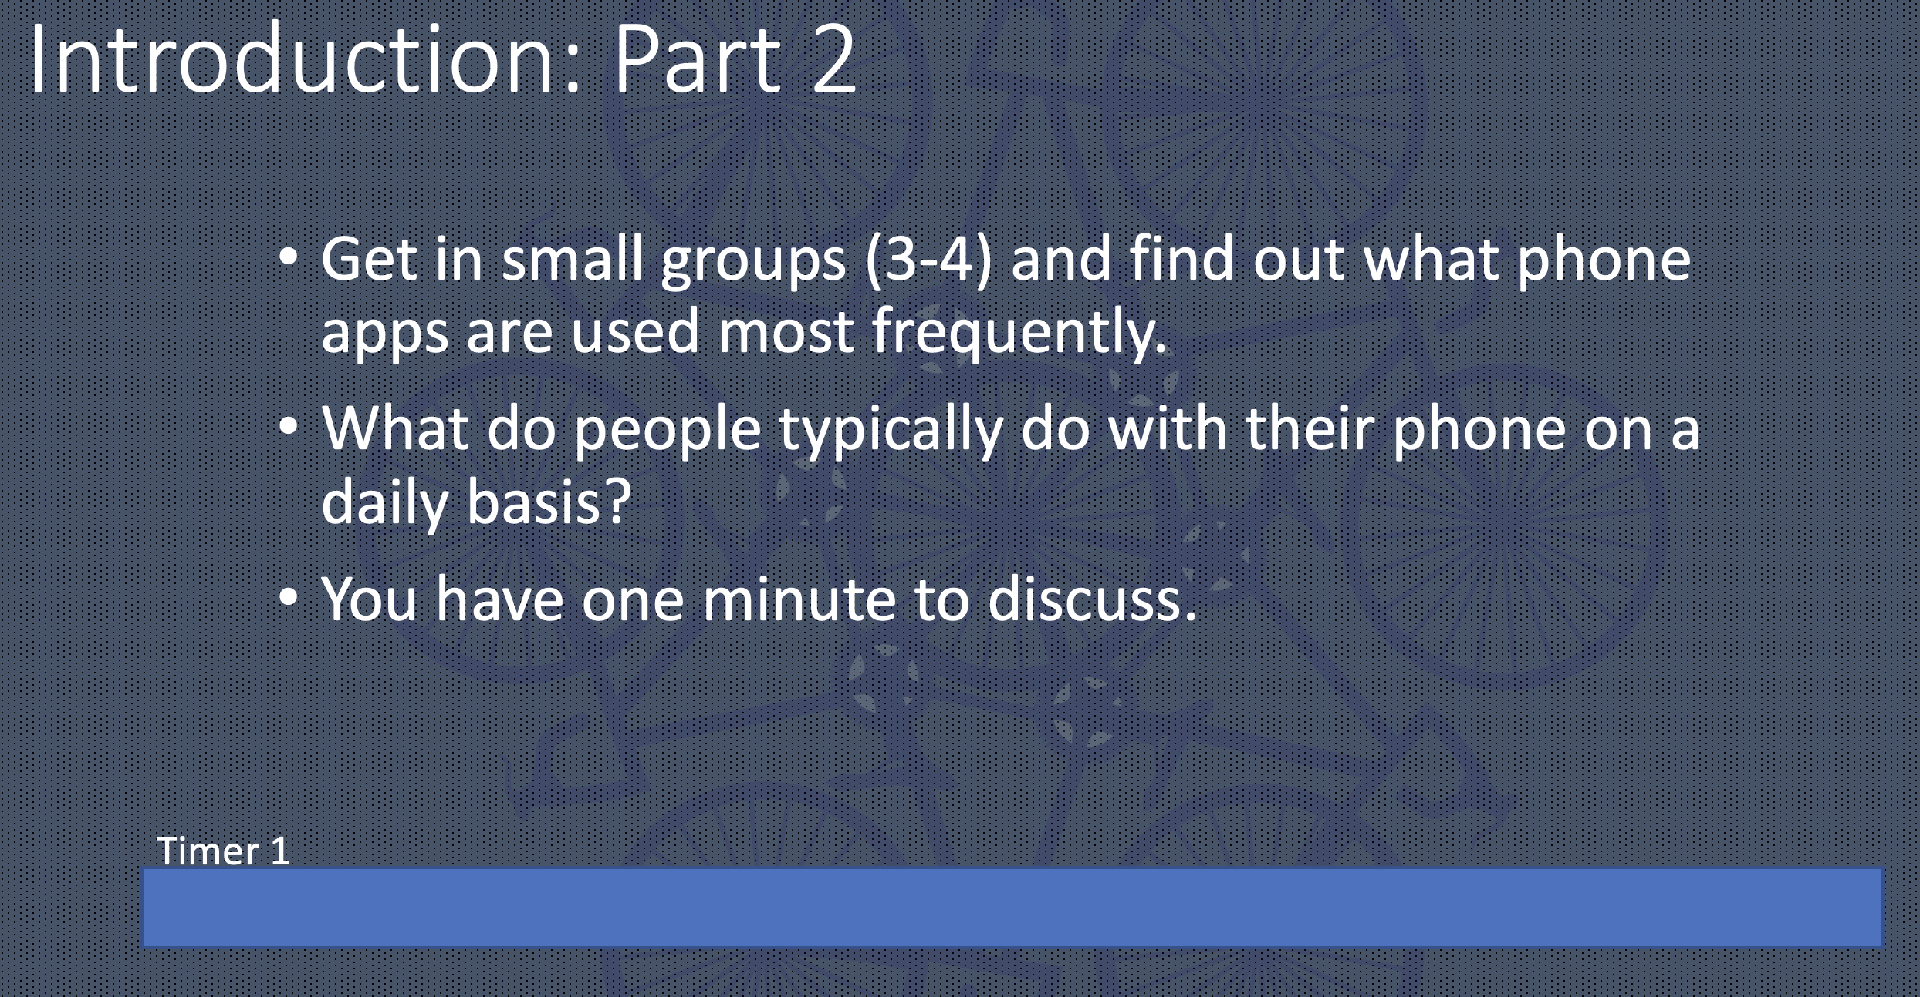
Intermediate
Function: Can create with language, ask and answer simple questions on familiar topics, and handle a simple situation or transaction
Accuracy Expectation:
Content:
Text Type:
What are the minimum linguistic features needed to be successful?

Slide 10
Intermediate
Function: Can create with language, ask and answer simple questions on familiar topics, and handle a simple situation or transaction
Accuracy Expectation: Can be understood by sympathetic listener
Content: Daily life
Text Type: Sentences and strings of sentences

Slide 11
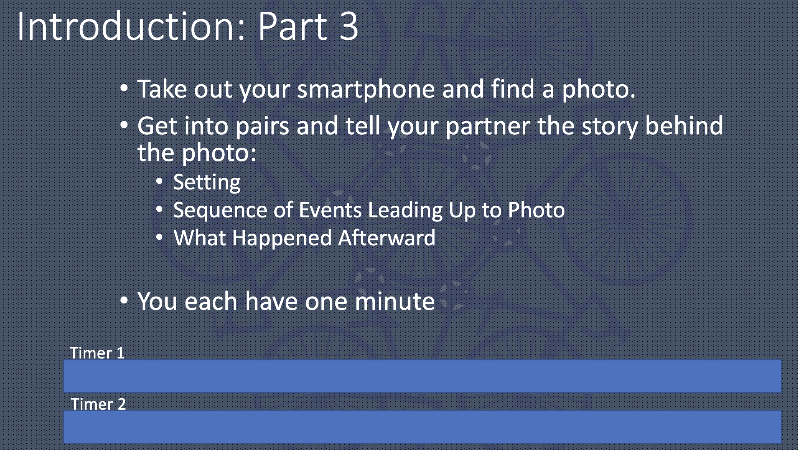
Advanced
Function: Can narrate and describe in all major time frames and handle a situation with a complication
Accuracy Expectation:
Content:
Text Type:
What are the minimum linguistic features needed to be successful?

Slide 12
Advanced
Function: Can narrate and describe in all major time frames and handle a situation with a complication
Accuracy Expectation: Can be understood by monolinguals not accustomed to language learners
Content: Community and concrete world
Text Type: Oral Paragraphs

Slide 13
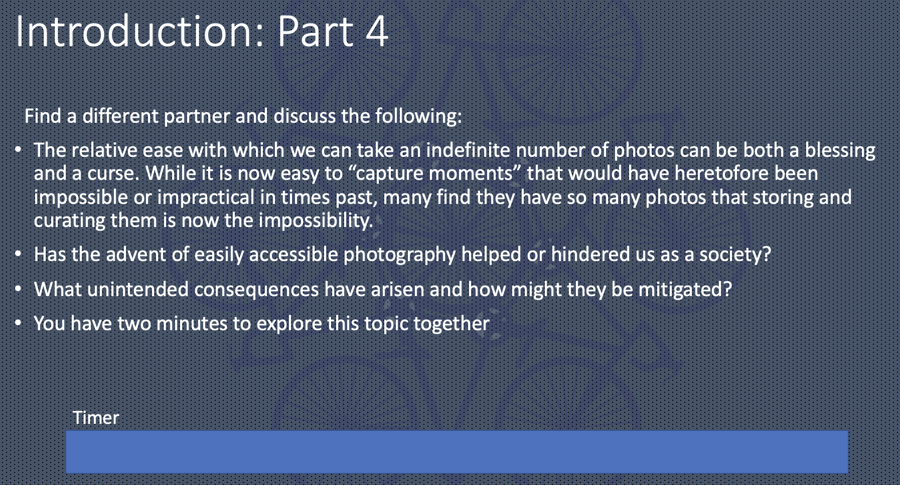
Superior
Function: Can support opinion, hypothesize, discuss topics concretely and abstractly, and handle a linguistically unfamiliar situation
Accuracy Expectations:
Content:
Text Type:
What are the minimum linguistic features needed to be successful?

Slide 14
Superior
Function: Can support opinion, hypothesize, discuss topics concretely and abstractly, and handle a linguistically unfamiliar situation
Accuracy Expectations: No patterned errors
Content: World of ideas
Text Type: Extended Discourse

Slide 15
ACTFL Criteria
Level | Novice | Intermediate | Advanced | Superior
Functions | Communicate minimally Use formulaic utterances Produce words, lists and phrases | Create with Language Participate in Simple Conversations Ask and Answer Questions Engage in simple transactions | Narrate and Describe in All Time Frames Past Present Future Linguistically negotiate situations with complications | Discuss Abstract Topics Extensively Support Opinion with Nuanced Language Explore hypothetical realities vis-à-vis conjecture
Accuracy | Only understood by patient, sympathetic listeners accustomed to nonnative speakers | Understood by people accustomed to speaking to nonnative speakers | Can be understood without confusion by monolinguals not accustomed to speaking to nonnative speakers | No patterns of errors in basic structures. Errors virtually never distract or impede communication
Content | Self | Self Daily Life | Self Daily Life Non-autobiographical Topics Topics of General Interest | Self Daily Life Non-autobiographical Topics Topics of General Interest Abstract Topics
Text Type | Words Lists | Sentences Strings of sentences | Paragraphs | Extended Discourse
Keep your FACTs straight and you are at a major level.

Slide 16

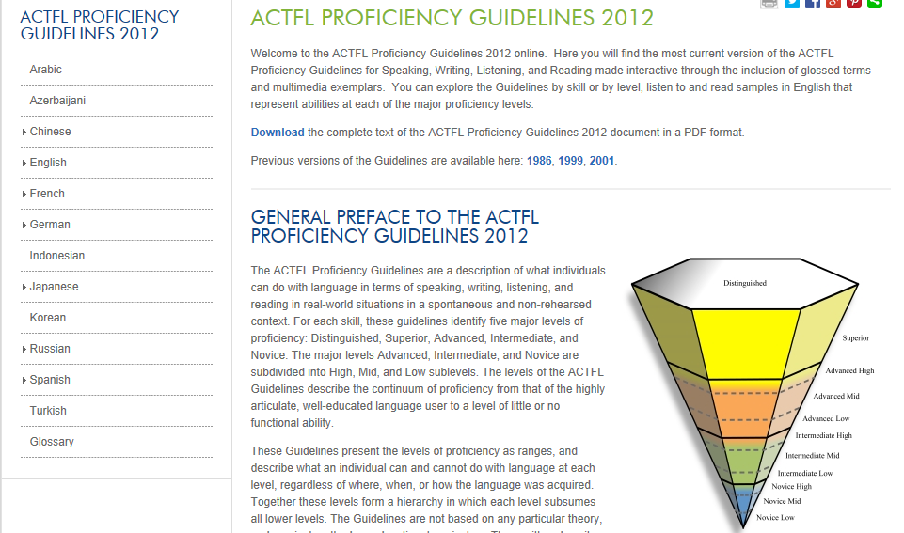
Notes:
Intended to show how the Guidelines section of the ACTFL website looks , not to be read

