Slide 1
PACE Model
Teaching Grammar in Context
Change the task-not the text

Slide 2

PACE Model
Presentation
Attention
Co-Construct
Extension activity
Notes:
Insert a map of your country.

Slide 3
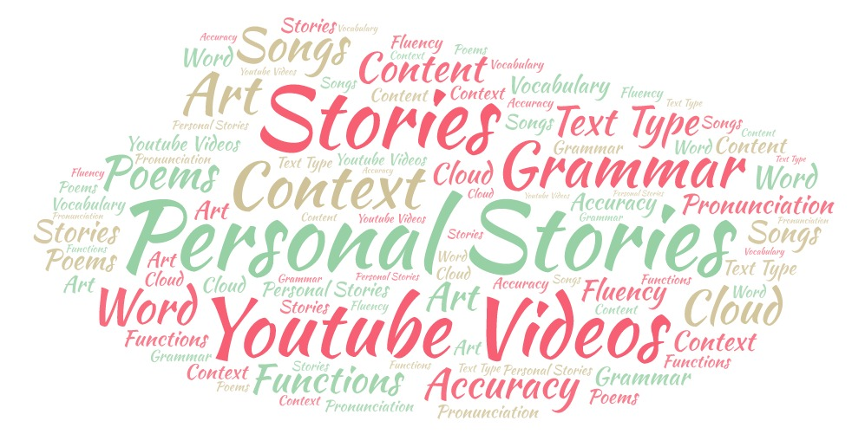
Presentation
Examples
1-Poems/Fables
2-Personal stories
3-Youtube videos: (with or without subtitles)
4-Songs
5-Story Telling (books & short stories)
Notes:
Insert a picture of one of the geographic features of your country.

Slide 4
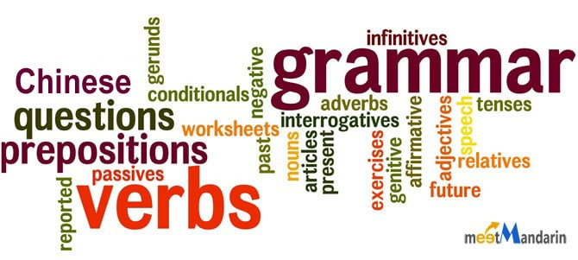
Attention
The teacher focuses the students’ attention on the language form or structure through the use of images, powerpoint slides, songs, or highlighting a particular linguistic form.
Notes:
Insert a picture illustrating a season in your country.

Slide 5
CO-CONSTRUCT AN EXPLANATION
Together, the teacher and students co-construct the grammatical explanation. The teacher provides scaffolding by using questions that guide the students to discover the structure. Students suggest the grammar rules guided by the teacher, making sure they end up with the appropriate explanation.
When is the verb used?
Is it present, future, or past tense?
What is the ending of the verb?
How is it different from the perfect tense?
Is it used for repeated or one-time activities?
Notes:
Insert a picture of an animal and or plant found in your country.

Slide 6

EXTENSION ACTIVITY
Students engage in activities in which they have opportunities to use the grammatical structure they studied.
Write a personal story
Write the conclusion of a story
Information-gap activities
Role-play situations
Paired interviews
Class surveys
Simulations
Cloze activities
Notes:
Insert a picture of an animal and or plant found in your country.

Slide 7
Co-Construct Question
What are some transitions that are used in the story?
D’abord
Ensuite
Puis
Donc
Après
Cependant
Et
Mais
Lorsque
Parce que
Enfin, Finalement
First of all
Next
Then
So
After
However
And
But
When
Because
Finally, Eventually

Slide 8
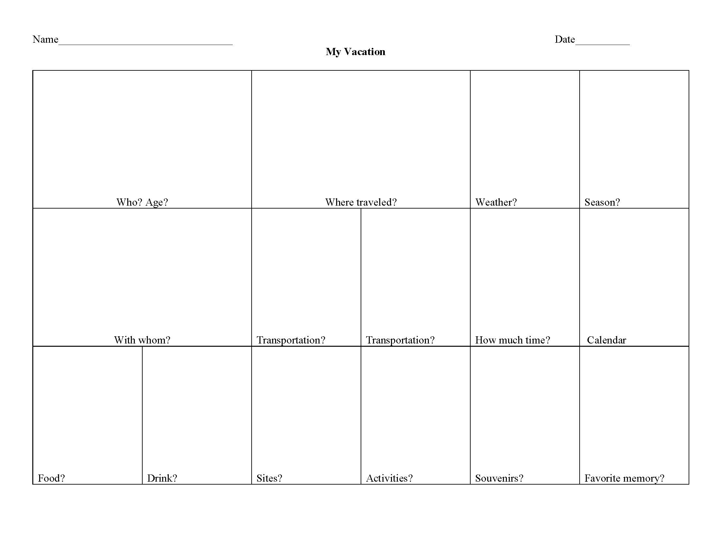
Expansion (see hand-out)
Write a personal experience about one of the following topics:
Trip
Accident
Unusual experience
In the story, include at least 8-10 examples of transitions and past participles and draw a picture in each box. Practice and present it to a partner
Notes:
Insert a picture of an animal and or plant found in your country.

Slide 9
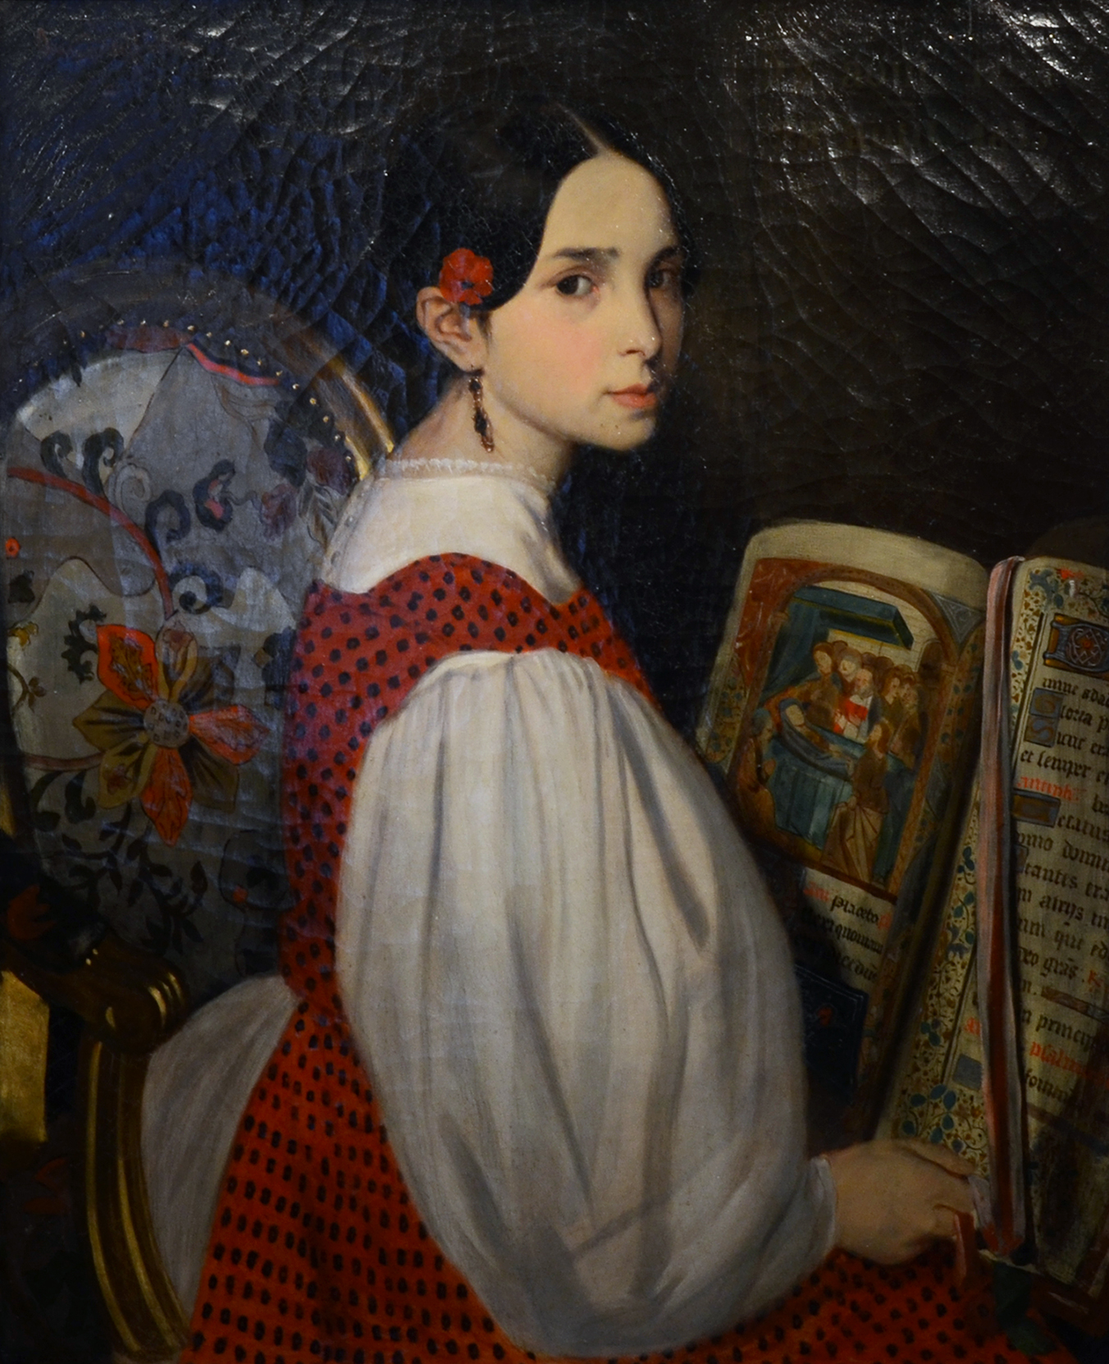
Léopoldine Hugo
(poem background)
Daughter of Victor Hugo (who wrote Les Misérables and Hunchback of Notre Dame), Léopoldine married Charles Vacquerie on 15 February 1843, but they both drowned together only a few months later, when their boat capsized on the Seine river on 4 September 1843. She was 19 years old and pregnant and she died when her wet, heavy skirts pulled her down, and her husband died trying to save her. This tragic event had a great impact on the work and personality of her father, Victor Hugo. He dedicated numerous poems to the memory of his daughter, notably Demain dès l'aube. Victor Hugo did not write for several years afterwards owing to the clinical depression he developed following Léopoldine's death.
Notes:
Insert a picture of one of the points of interest for your country.

Slide 10
Victor Hugo POEM
Presentation-meaning
Tomorrow, at dawn, when the countryside is white,
I will leave. You see, I know you're waiting for me.
I will go through the forest, I will go across the mountains.
I can not stay away from you any longer.
I will walk with my eyes fixed on my thoughts, Without seeing anything outside, without hearing any noise,
Alone, unknown, my back bowed, my hands crossed,
Sad, and the day for me will be like night.
I will not look at the evening gold falling, nor the sails in the distance going down to Harfleur, And when I come, I will put on your grave a bouquet of green holly and heather in bloom.
How do you think Victor Hugo felt while writing about his daughter’s death?
How would you feel?
What did he mean when he stated “I know you are waiting for me?”
What do you think is the meaning of this poem?

Slide 11
Victor Hugo POEM
Attention-future tense
Demain, dès l'aube, à l'heure où blanchit la campagne,
Je partirai. Vois-tu, je sais que tu m'attends.
J'irai par la forêt, j'irai par la montagne.
Je ne puis demeurer loin de toi plus longtemps.
Je marcherai les yeux fixés sur mes pensées,
Sans rien voir au dehors, sans entendre aucun bruit,
Seul, inconnu, le dos courbé, les mains croisées,
Triste, et le jour pour moi sera comme la nuit.
Je ne regarderai ni l'or du soir qui tombe,
Ni les voiles au loin descendant vers Harfleur,
Et quand j'arriverai, je mettrai sur ta tombe Un bouquet de houx vert et de bruyère en fleur.
Tomorrow, at dawn, when the countryside is white,
I will leave. You see, I know you're waiting for me.
I will go through the forest, I will go across the mountains.
I can not stay away from you any longer.
I will walk with my eyes fixed on my thoughts, Without seeing anything outside, without hearing any noise,
Alone, unknown, my back bowed, my hands crossed,
Sad, and the day for me will be like night.
I will not look at the evening gold falling, nor the sails in the distance going down to Harfleur, And when I come, I will put on your grave A bouquet of green holly and heather in bloom.
Notes:
Insert a picture that illustrates some part of your country’s economy.

Slide 12
Victor Hugo POEM
Co-construct-Identify the future tense verbs
Demain, dès l'aube, à l'heure où blanchit la campagne,
Je partirai. Vois-tu, je sais que tu m'attends.
J'irai par la forêt, j'irai par la montagne.
Je ne puis demeurer loin de toi plus longtemps.
Je marcherai les yeux fixés sur mes pensées,
Sans rien voir au dehors, sans entendre aucun bruit,
Seul, inconnu, le dos courbé, les mains croisées,
Triste, et le jour pour moi sera comme la nuit.
Je ne regarderai ni l'or du soir qui tombe,
Ni les voiles au loin descendant vers Harfleur,
Et quand j'arriverai, je mettrai sur ta tombe Un bouquet de houx vert et de bruyère en fleur.
Tomorrow, at dawn, when the countryside is white,
I will leave. You see, I know you're waiting for me.
I will go through the forest, I will go across the mountains.
I can not stay away from you any longer.
I will walk with my eyes fixed on my thoughts, Without seeing anything outside, without hearing any noise,
Alone, unknown, my back bowed, my hands crossed,
Sad, and the day for me will be like night.
I will not look at the evening gold falling, nor the sails in the distance going down to Harfleur, And when I come, I will put on your grave A bouquet of green holly and heather in bloom.
Notes:
Insert a picture that illustrates some part of your country’s economy.

Slide 13
Victor Hugo POEM
Extension Activity
Extension Activity
Write about your short-term future using the future tense. Use 15 examples of what you think will happen in the next three years.
Things to consider:
What majors/minors you will have?
Where you will live?
Who will be your friends?
When will you graduate?
Will you continue on to graduate school?
If so, where?
What will be your first job?
What will be your career?
Who will you marry?
What will be your favorite class?
Will BYU beat the U of U in football

Slide 14
Story Telling Goal
Intermediate vs Advanced
What are some of the differences between intermediate vs advanced proficiency?
Paragraph vs Sentence level (text type)
Transitions vs choppy sentences
Functions (story telling vs creating sentences)
Accuracy (grammar, pronunciation, vocabulary, fluency)

Slide 15
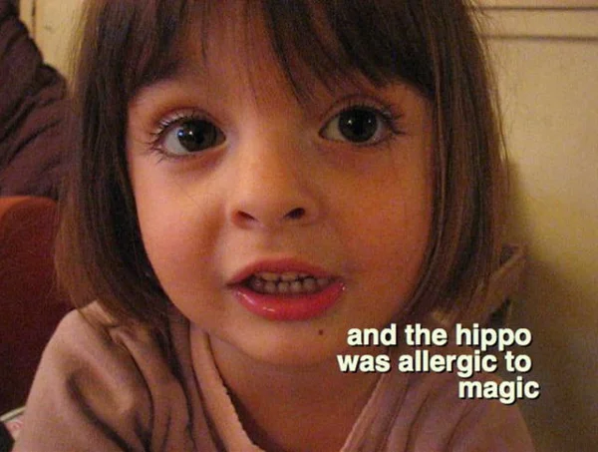
Video example-cute French girl
https://vimeo.com/2113477
Notes:
Add key points in the history of your country to the timeline.

Slide 16
PACE with video (see hand-out)
Presentation-Write a short summary (2-3 sentences) of the meaning of the assigned paragraph
Attention to form and structure (imperfect verb tense). Circle the number of imperfect verbs in the assigned paragraph
Co-construct an explanation of the imperfect verb tense
Extension BEP Story-write an ending to the story with at least five sentences
Notes:
Insert a picture illustrating a custom or tradition here.

Slide 17

Song-je suis tombé
https://www.youtube.com/watch?v=QgL_Yp7kvw8
Notes:
Insert a picture of the head leader of your country.

Slide 18
PACE with video (see hand-out)
Presentation-Write a short summary (2-3 sentences) of the meaning of the assigned paragraph
Attention to form and structure (past tense). Examples of sentences in the passé composé:
J'ai oublié qui j'étais et je suis tombé
J'ai vu ma vie
J'ai oublié l'horizon
Co-construct an explanation of the past tense verb
Extension A: Transcribe the missing words from the song with the correct past participle (cloze activity).
Extension B: Describe instances from your life when you have fallen down and what you did afterwards
Notes:
Insert a picture illustrating a custom or tradition here.

Slide 19
Short Stories
Read a short story with students and have them identify grammar points as you read the story.
Instructors give students grammar points to look for as they read the story and students identify them with the instructor while reading the story.
Examples could be: comparisons, superlatives, verb tenses, adjective agreements, interrogatives, etc.

Slide 20


