Slide 1

Getting Students to Talk!
Ellen Knell
Center for Language Studies

Slide 2
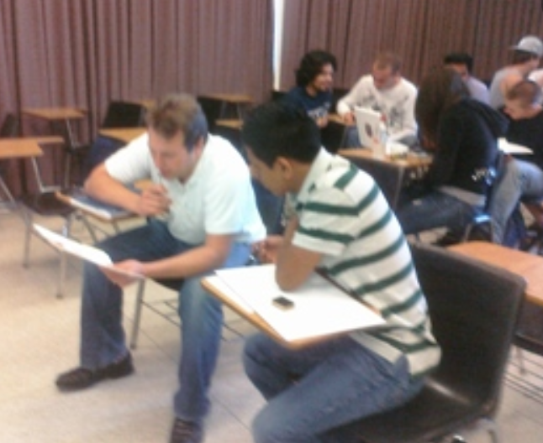

Talking in the L2 is the…
cornerstone on which we build literacy and language learning
  builds vocabulary
  builds communication skills
  builds critical thinking
  Increases language proficiency
Notes:
Why??? Getting our students to talk is really important because we build everything on this.
by giving lots of opportunity to practice, we are helping them to improve their language Research has shown that this is really important

Slide 3
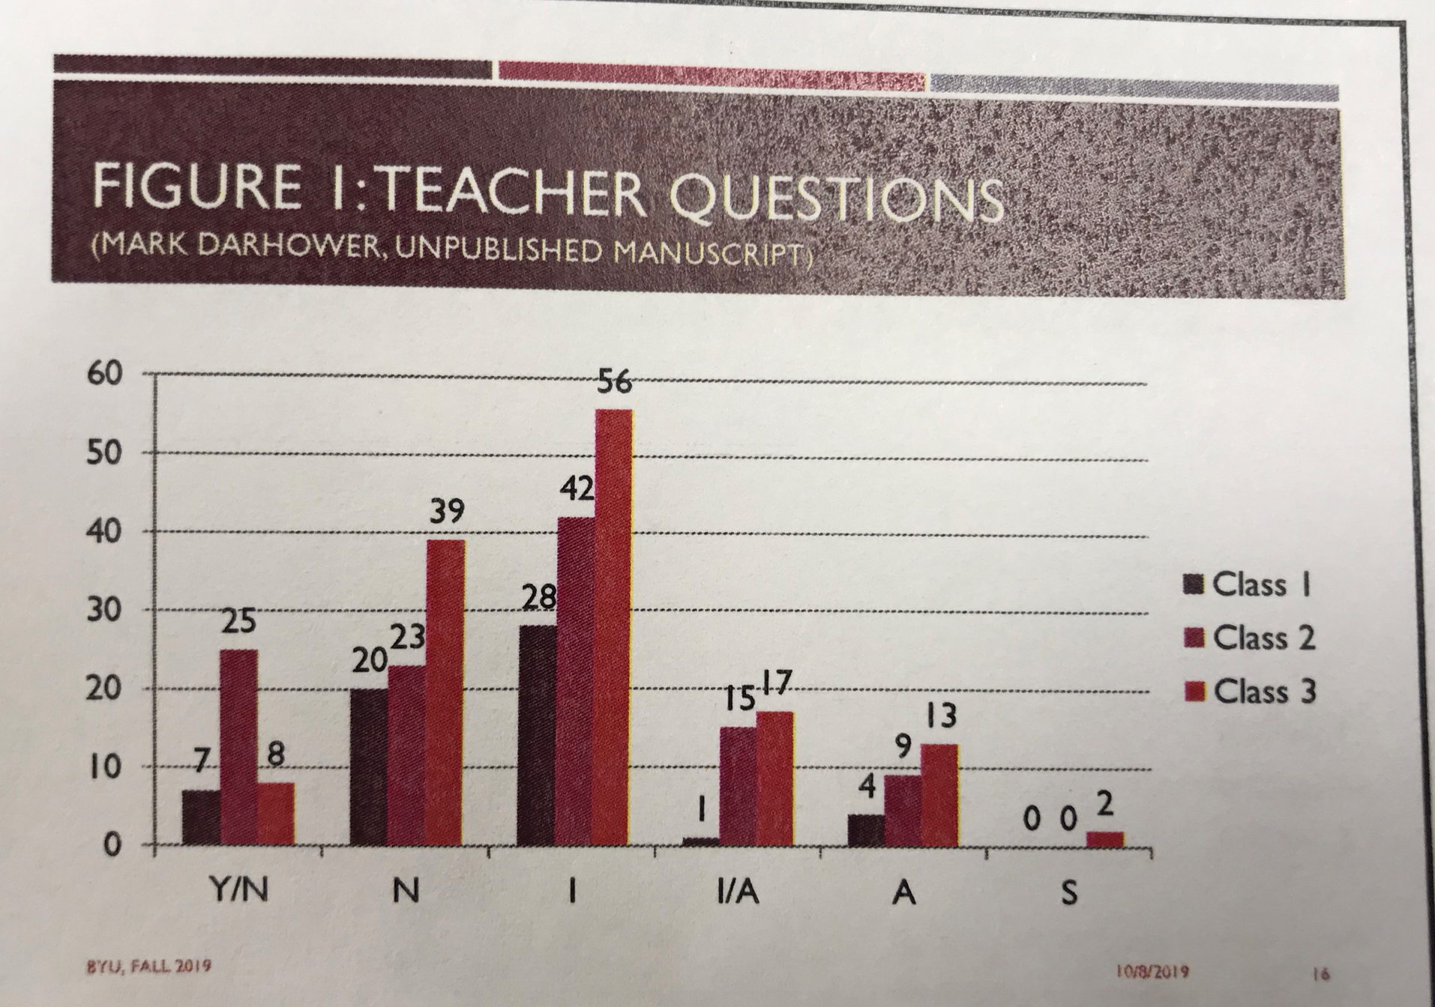
Questions and Discussion
Notes:
research - teachers talk too much Elizabeth Bernhardt-Kamil Stanford Language Center Teaching language through literature and literature through language - CBI courses oriented toward literature but not enough talking and discussing something I have observed almost every teacher (including me) can do better. students say they are concerned with - that they are not doing enough talking

Slide 4

Scaffolding Oral Responses
Notes:
Today - we’re going to talk about how to help our students talk more. - how can we scaffold - 5 ways
Hong Kong I want to give you a few ways to scaffold your students’ speaking support while building
questions/prompts, sentence frames, graphic organizers, bounce cards

Slide 5

Scaffold
Students’ Language
#1 Use the question hierarchy
Teach students Circumlocution
Notes:
5 ways to scaffold language - hand
Question hierarchy - (remember??) talked about it when i talked about how to give comprehensible input password

Slide 6
Elaborate and Extend
Students’ Language
Use the question hierarchy
  gestures
  yes/no
  either/or
  “wh” closed questions
  open-ended questions
  “Tell me more,” “Why,” “How”
  “Can you expand on what _______ said”
Circumlocute – talk around the vocabulary they don’t know
Notes:
5 ways to scaffold language - hand Circumlocute - have students practice - Have them describe to another student a vocabulary word but they can’t use that word - word depends on the level (Bicycle, education/government)
Question hierarchy - (remember??) talked about it when i talked about how to give comprehensible input

Slide 7
#1- Teacher-Student Interaction
IRE (Initiate, Respond, Evaluate)
IRF (Initiate, Respond, Follow-up)
  What are some Chinese wedding customs?
  What’s the capital of China?
Initiate
Initiate
  Beijing
  Brides in China may wear a long red wedding dress.
Respond
Respond
  That’s right!
  Tell me more about that? Why would brides wear a red wedding dress?
Evaluate
Follow-up
Notes:
We can have either an IRE class or an IRF class. Here’s what I mean by that IRE is often what we think of as a typical teacher-student interaction. IRF You are asking a question that gets your students to speak more - it continues the conversation. That’s an important skill for them to learn You should also encourage your students to ask questions - love being in a classroom where the students want to talk and ask questions

Slide 8
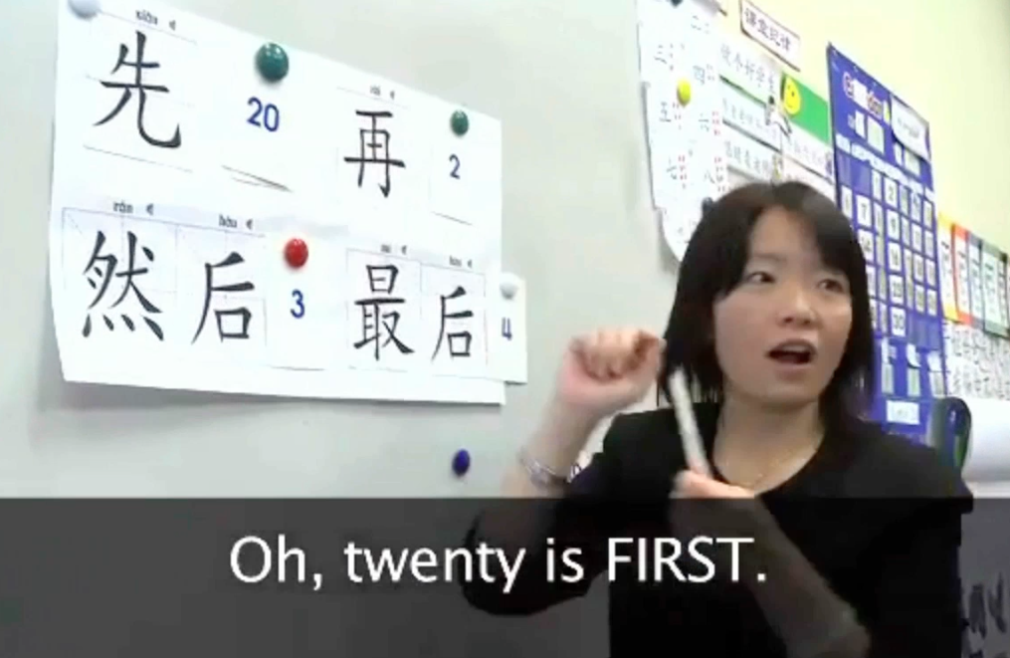
#2. Sentence Frames
Notes:
Your students may not know where to start when you ask them to discuss
Second scaffolding technique to help our student speak more. Did numbers then had them talk about their schedule

Slide 9

3. Graphic Organizers
Venn Diagram
Notes:
go online and search for Graphic organizers. WHy Use??? helps structure the information so the student can talk about it. What is a venn diagram used for? Weddings in China vs. weddings in America (culture)

Slide 10

Notes:
T-Chart - what should you use this for?? look at traditional vs. modern Chinese weddings. compare and contrast

Slide 11
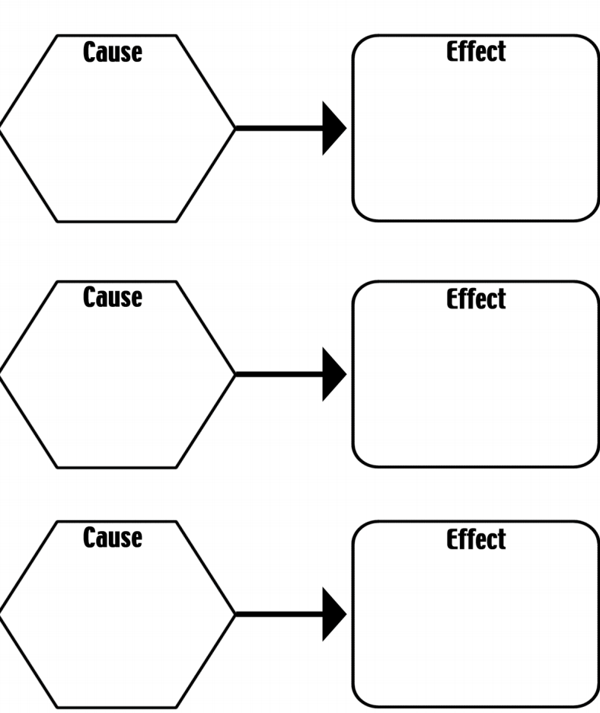
Notes:
This can be very helpful when you are talking about historical or current events which you should be doing in 330
lots of different charts - one cause or two effects or three effects etc.
google What were the causes of the bombing of Laos during the Vietnam War?

Slide 12
#4. Elaborate with Bounce Cards-
Ways to Keep the Discussion Going
Bounce: Take what your classmate(s) said and bounce an idea off of it
“That reminds me of…”
“I agree, because…”
“True, another example is when…”
“That’s a great point…”
Sum it up: Rephrase what was said in a shorter version
“I hear you saying that…”
“So if I understand correctly…”
“I like how you said…”
Inquire: Understand what your classmates mean by asking them questions
“Can you tell me more about that?”
“I’m not sure I understand…”
“I see your point, but what about..?”
“Have you thought about…?”
Notes:
Sometimes students don’t know how to have conversations/discussions - they don’t know what to say in the target language so we should help them with that language - particularly at the novice or intermediate levels - there are helpful when comes to communication in marriage!! colored sentences are in the target language.

Slide 13
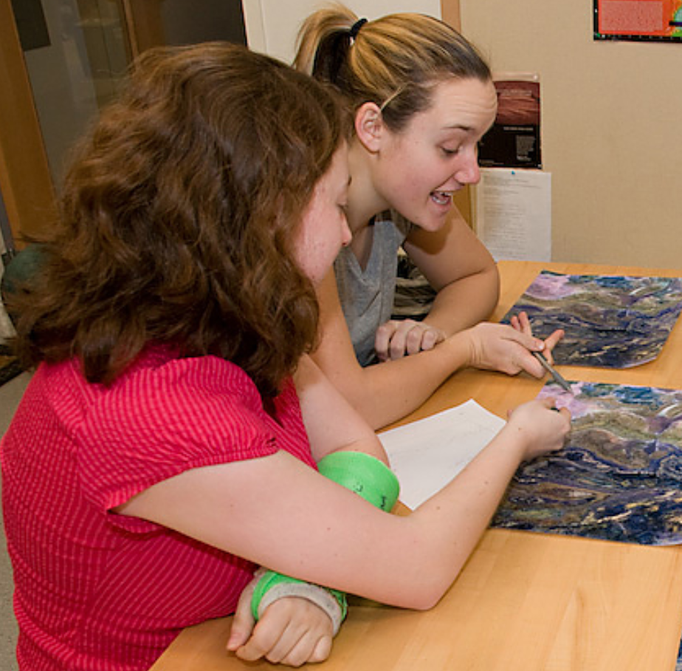
#5. The less you talk the more
your students will!
When giving whole class instruction asks lots of questions.
Before students answer a question have them talk to their partner.
Ask another questions -
have them talk to another
partner
Notes:
Simple technique that teachers often forget. Don’t just ask a question and have students raise their hands.
Single most important way to get students to interact. Simple - have them talk to a partner or group - new partner

Slide 14
Summary -5 Ways to Support
Oral Language
Question hierarchy -
  IRF initiate, respond, follow-up
  open-ended questions
Sentence Frames
Graphic Organizers
Bounce Cards - ways to discuss in the TL
When you ask a question, have your students talk to their partner

Slide 15
Think - Pair - Share
Think about an activity that you have done in your class that got your students speaking.
Find a partner and share your activity. Next listen to your partner’s activity.
Share with another partnership or with the class.
Notes:
Next we’re going to talk about Activities that you can do with your students/
You should have a variety of pair and group work. This will keep your class interesting.

Slide 16
  Student Output Activities
  Think-Pair-Share
  Survey
  Information Gap
  Role Plays (add Dave’s handout)
  Instant Expert
  Gallery Walk (pics)
  Fishbowl
  Debate
Notes:
Variety of core activities that you can do with any topic and any level. This may give you some ideas.
pass out handout

Slide 17
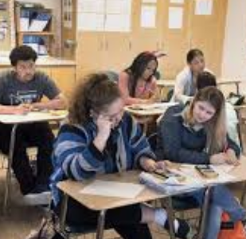
Think-Pair-Share
Turn and Talk
Notes:
don’t always stay with the same partner - change

Slide 18
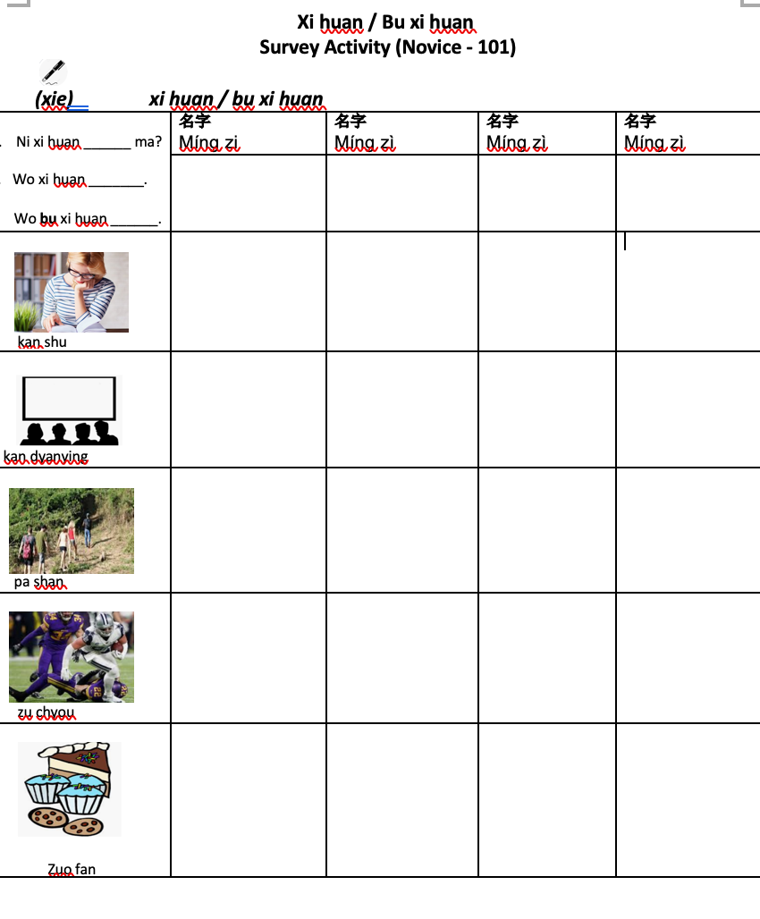
Survey Activity
Do you like……? / Don’t you like….?
Notes:
After CI - have students use the language. Always model first – don’t need to use English. - pictures/ sentence-frames
Sometimes it’s OK to use English if you have a lot of instructions like in a role play activity
Happy to come to your class and help you

Slide 19
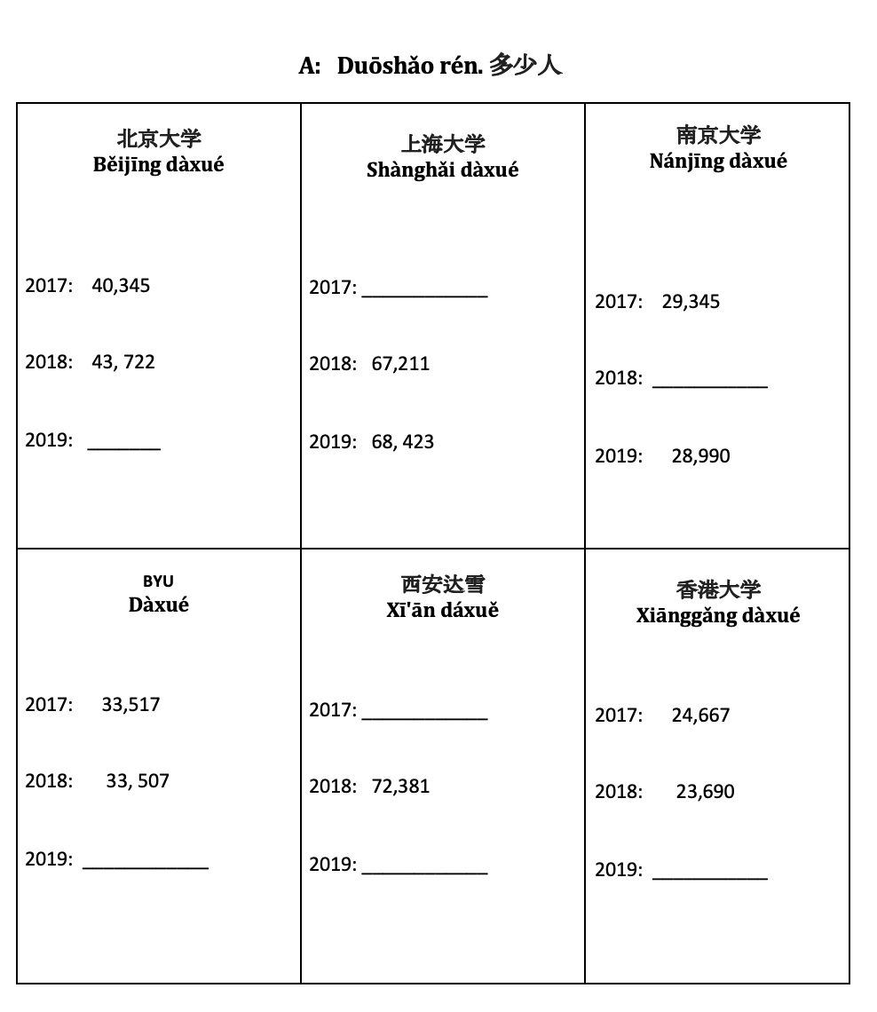
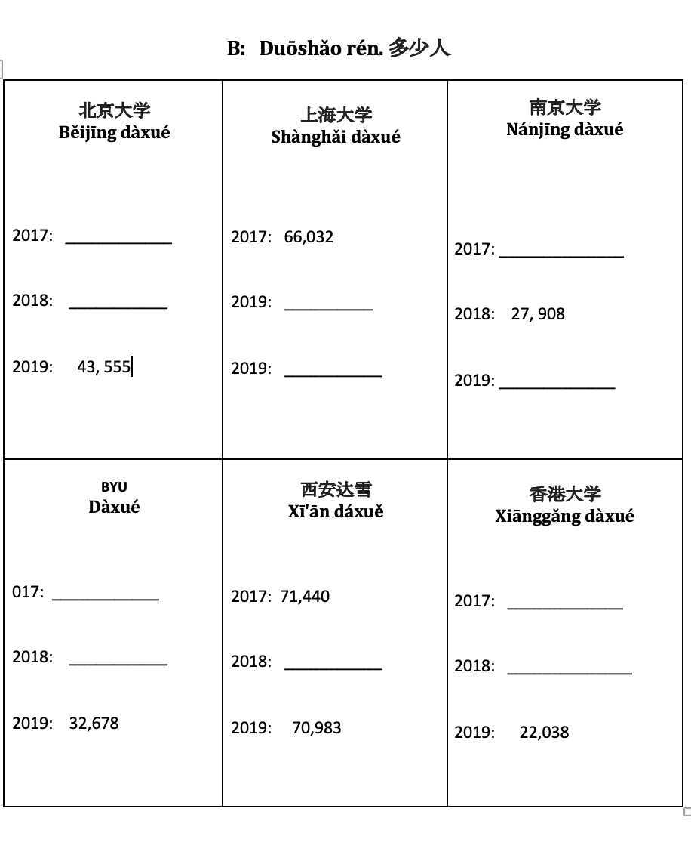
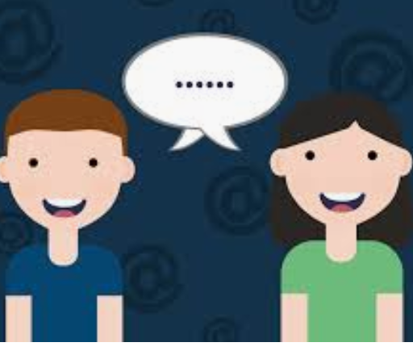
Information-Gap Activity
University Student Population According to Year
Information – Gap Activity
Notes:
Students given task - each have some of the information needed to accomplish the task - must talk together. (Gap)
Also Cultural reviewed how to say the numbers and ask the questions before

Slide 20
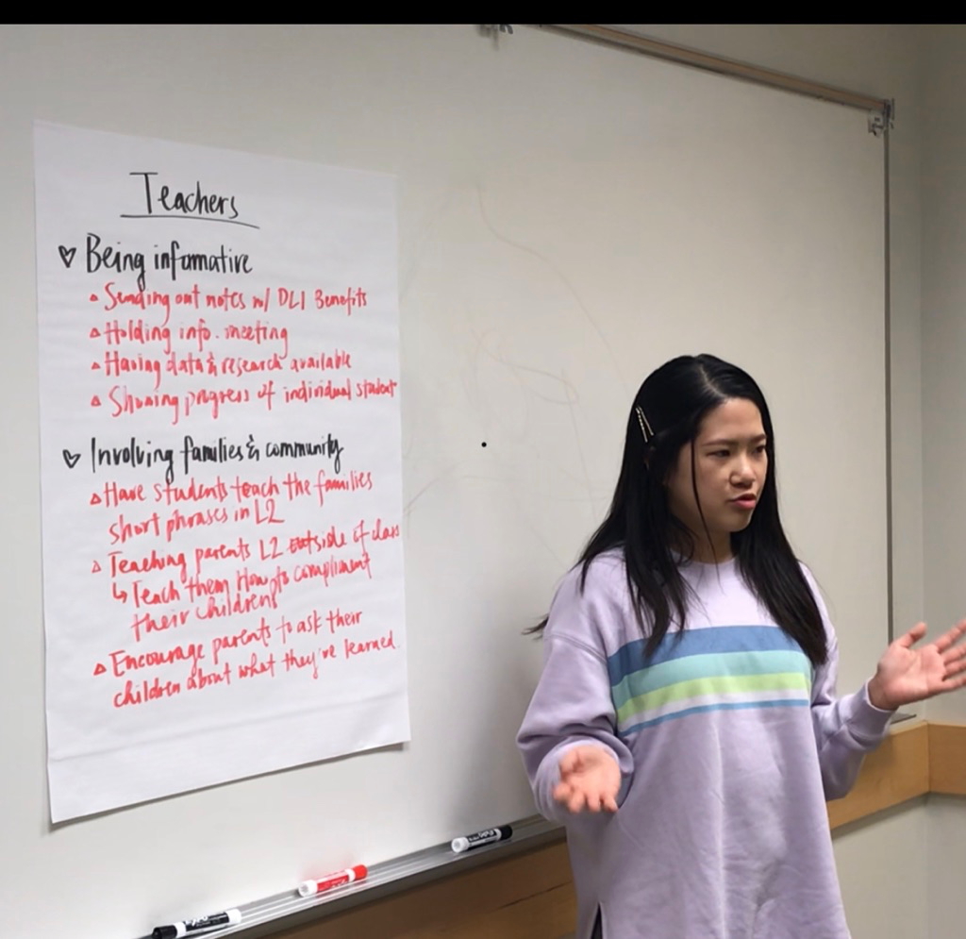
Instant Expert
Each group is responsible for becoming an expert on some aspect of the text or task.
Then they report out to the class
Notes:
need permission from students for pictures?? Stake-holders for immersion education parents, community leaders, principals and school staff

Slide 21
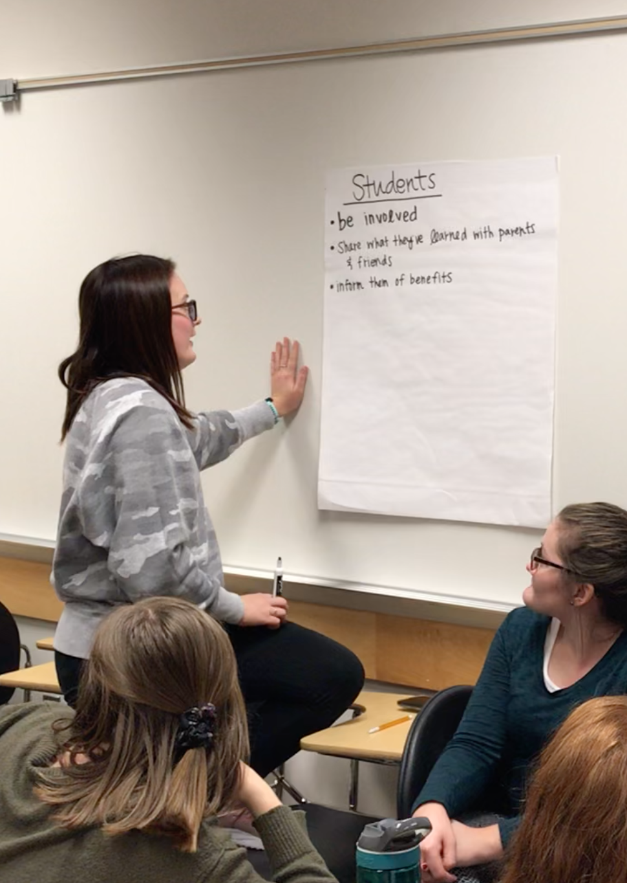
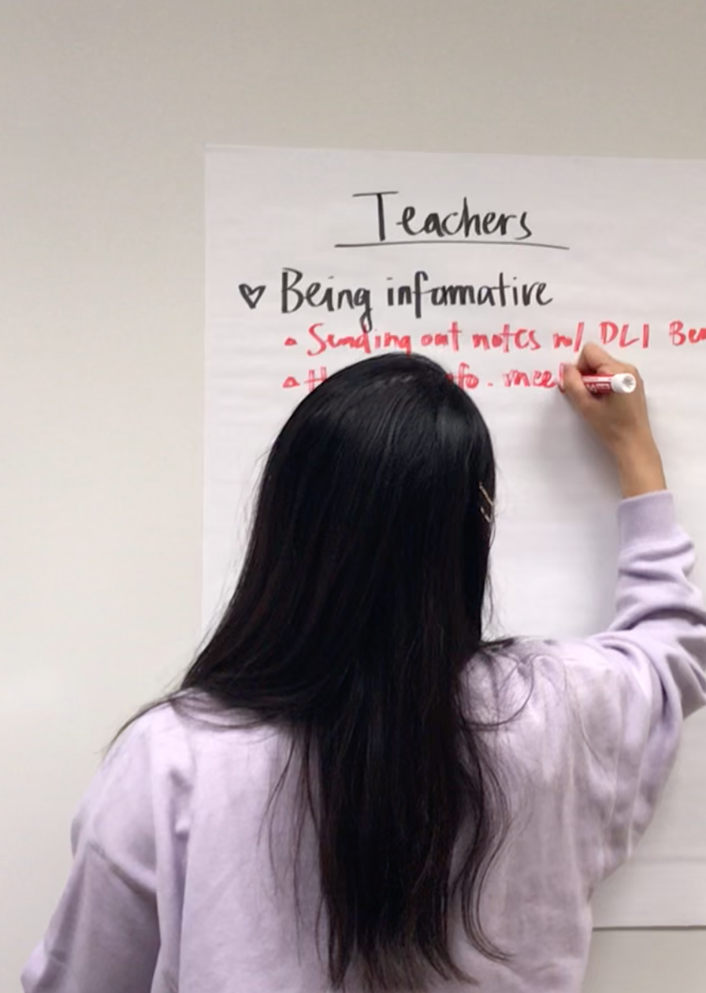
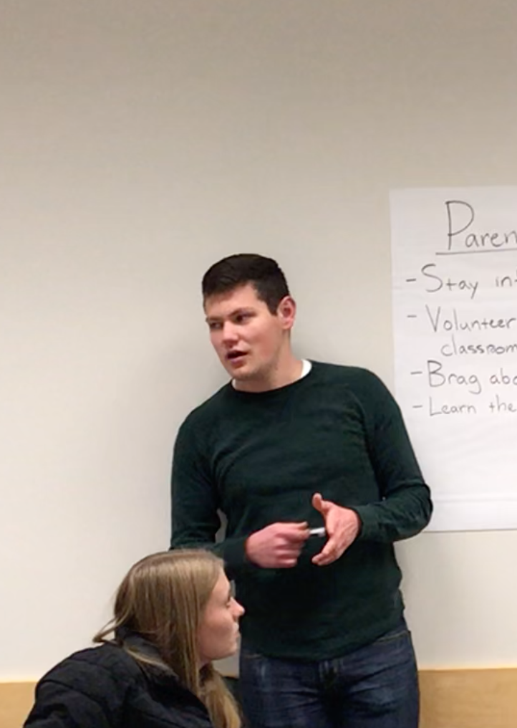
GALLERY WALK
GIVE PROMPT/QUESTION
DISCUSS WITH GROUP AND WRITE ON POSTER
GROUP MOVES TO A NEW POSTER AND ADDS TO a new PROMPT
AFTER LAST ROTATION - REPORT TO CLASS
Notes:
if have a student that dominates - tell students that you want someone who hasn’t presented to talk

Slide 22
Role-Plays
Meeting at the Movies Author: K. Morgan (Texas)
ROLES: Friends
TOPICS: Leisure Time
FUNCTIONS: Explaining, negotiate, exchange opinions, persuading
MOVIES A: You and your friend are meeting to see a movie this afternoon. You arrived first so you went ahead and bought the tickets. You bought tickets to see Star Wars because you have never seen it in a theater and you know your friend hasn't either. You friend is now approaching. How will you explain that you already bought the tickets and get him/her to reimburse you?
MOVIES B: You and your friend are meeting to see a movie. You have decided that you only want to see a comedy today. If there are no comedies playing, you would prefer to go home and watch TV or study. How will you explain this to your friend when you get to the theater?
Notes:
do handouts
Adjust according to level

Slide 23
  Student Output Activities
  Think-Pair-Share
  Survey
  Information Gap
  Role Plays (add Dave’s handout)
  Instant Expert
  Gallery Walk (pics)
  Fishbowl
  Debate
Notes:
Give copy of activities sheet
Taraeua – talk about debate

Slide 24

Fishbowl
Solutions
About 6 students sit in a circle and the rest of the students stand outside the circle
The students should address the first prompt:
What are challenges that can threaten the success of group work?
  The students sitting in the circle address the prompt
  Students on the outside should listen and take notes but not talk
  If a student on the outside wants to talk they should tap a person in the circle and exchange places
Have another group of students sit in the center - Give a new question
  Keep a list of main points on the board
  After the fishbowl, discuss with a pair or group the main conclusions reached
Notes:
Keep groups short - change often everybody participate

Slide 25
Fishbowl
What are some challenges to doing group work?
Notes:
students don’t know what to do Some students take over Some students won’t participate – jobs/ talking heads
Time – students need to talk but don’t give too much time All materials prepared ahead of time
Students should be accountable Scaffold prespeaking - modeling Students can be undisciplined and off task – structure the task and students should be accountable

Slide 26
Fishbowl
Possible Solutions
What are some possible solutions to the challenges raised about group work?
Notes:
change groups - variety of grouping, pairs etc.

Slide 27
Pair/Group Work
Carefully structure your group work
  Give students a time limit
All students should participate
  Jobs/roles (group leader, recorder, asks questions etc.)
  Numbered Heads
    Tell students that you will call a number from each group who will report out
Notes:
everyone needs to say something - bounce

Slide 28

Well Structured
Pair/Group Work
Pre- Activity
  Model (I do, We do,
you do)
  Preload language students will use
During Activity
  Monitor
  Notice mistakes. Discuss with class later
After Activity
  Accountable
  Produce something
Notes:
Chinese Survey - I do , We do, You do

Slide 29
Summary/Application
Design an Activity
What topic?
How will you group students?
What activity?
  What will you do before?
  What will you do during?
  What will you do after?
Notes:
CHALLENGE: Think about your next lesson and how you can have your students talking as much as you.

