Slide 1
Proficiency Instruction
Dr. Ellen Knell
Brigham Young University
Notes:
Books, masks, Dave – Rubric, box dinner. Leave at 4:30

Slide 2

Critical Thinking Question
How is the concept of language proficiency different from knowing a language?
FLANG 377R

Slide 3
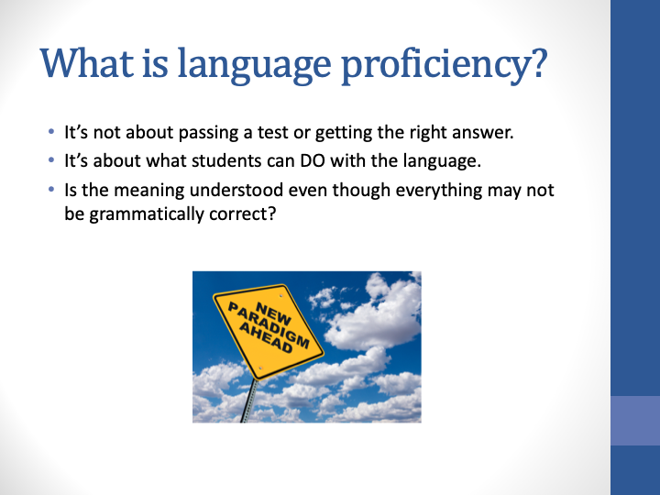
FLANG 377R

Slide 4
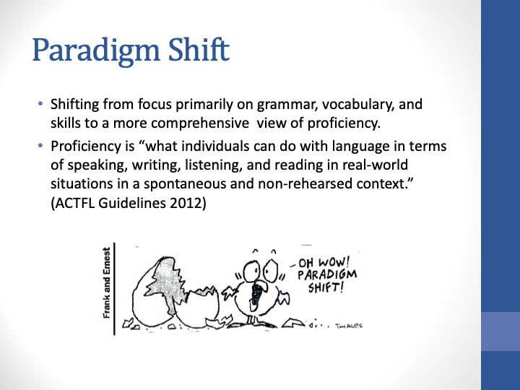
FLANG 377R
Notes:
Memorize dialogues but could only say what was in the dialogue

Slide 5
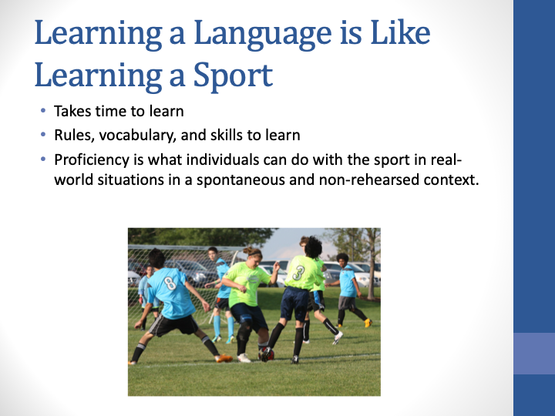
FLANG 377R
Notes:
It’s like when you play the game

Slide 6
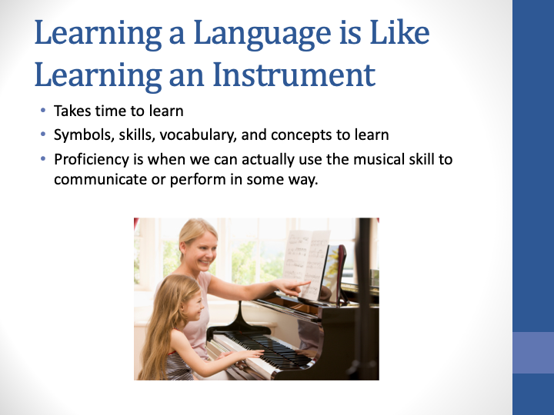
FLANG 377R
Notes:
Students learn to read or sight read music

Slide 7
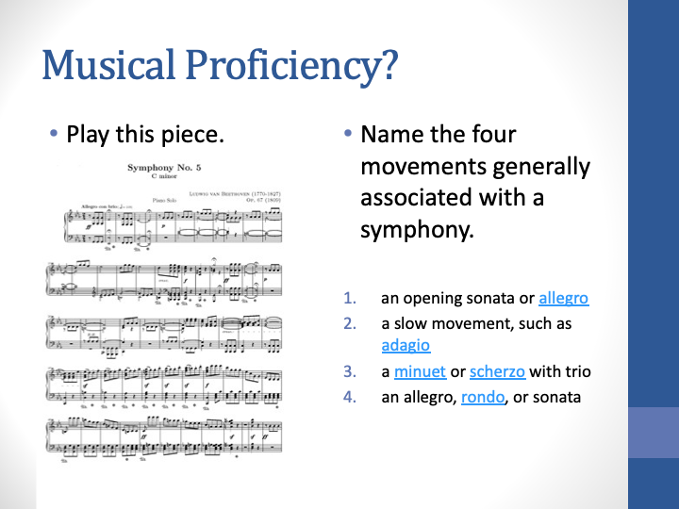
FLANG 377R
Notes:
Let’s look at these two tasks to help illustrate proficiency. Declarative and procedural knowledge

Slide 8

Output
What are the three modes of communication?
FLANG 377R
Notes:
A brief Review of the proficiency levels
Interpersonal (speaking with others - writing), presentational (speaking, writing), interpretive (reading, listening)

Slide 9



3 Modes of Communication
Interpretive
  Reading
  Listening
Presentational
  Speaking
  writing
Interpersonal
  Listening and speaking (conversation)
FLANG 377R

Slide 10
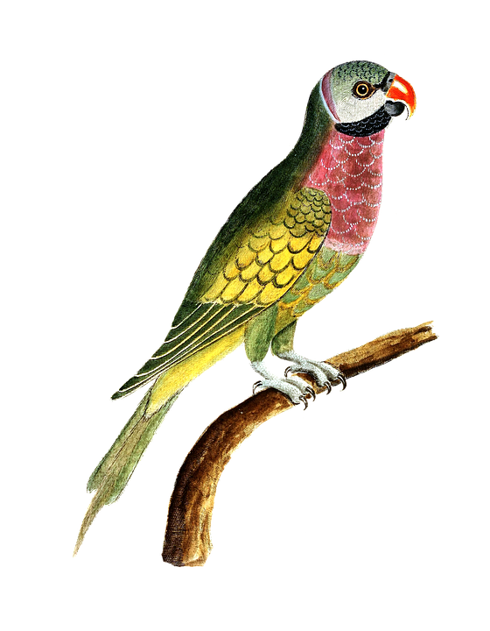
Proficiency Levels
Why do we call novice level learners “The Parrot?”
FLANG 377R
Notes:
Go over novice, Intermediate, Advanced - these will be the levels that you will be teaching
Formulaic language

Slide 11
Proficiency Levels
Novice (the parrot)
Words/phrases/simple sentences
Learned chunks of language (formulaic)
Novice high - basic exchanges about
everyday life
FLANG 377R
Notes:
Not mindless repetition - but formulaic chunks
Greetings, likes/dislikes, activities, daily plans, family, school, community etc.

Slide 12

Proficiency Levels
Why do we call an Intermediate Learner “The Survivor”?
FLANG 377R
Notes:
Why does it symbolize

Slide 13
Proficiency Levels
Intermediate (The Survivor)
Handle survival situations and basic communication tasks
Initiate, sustain, and close conversations
Creates with language and makes many mistakes
Sentence level (sentences and strings of sentences
Native speakers can understand
FLANG 377R
Notes:
Takes the formulaic chunks and combines and recombines them and adapts them to create new language - get a little messy

Slide 14

Proficiency Levels
Why do we call advanced level students “Storytellers”?
FLANG 377R

Slide 15
Proficiency Levels
Advanced - The Storyteller
Narrates and describes (using details) in all time frames
Talks/writes in paragraphs
Can use media about current events and issues
Can talk about a complicating situation
FLANG 377R
Notes:
Flat tire, mixed up an appointment, some kind of misunderstanding Cards

Slide 16
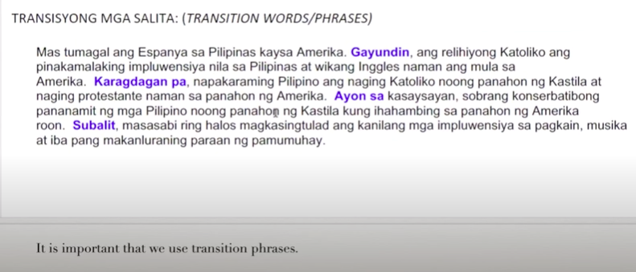
Transitions - Tagalog 330
https://youtu.be/B5rnG-4Id58
Notes:
Japanese Occupation

Slide 17
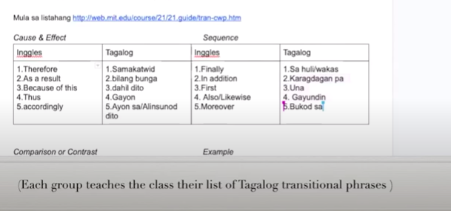
Transitions

Slide 18
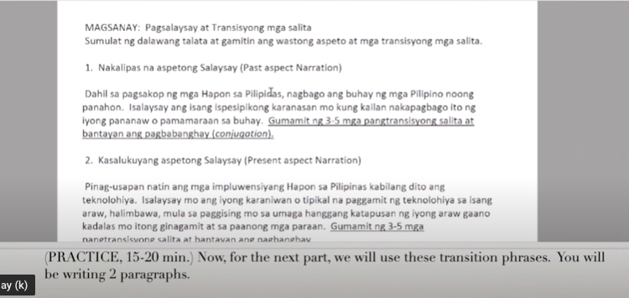
Transitions: Tagalog 330

Slide 19
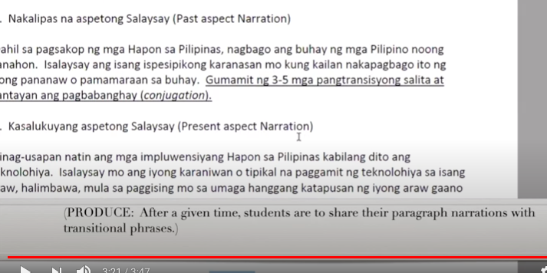
Transitions: Tagalog 330

Slide 20
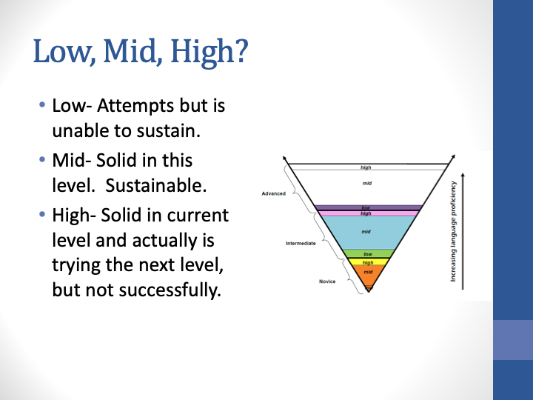
FLANG 377R
Notes:
From the actfl.org website wrong: Low is sustaining?

Slide 21
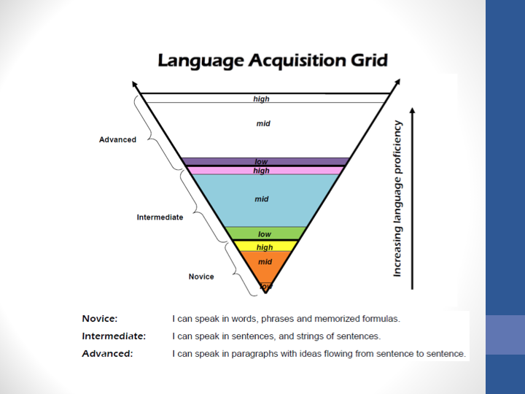
FLANG 377R

Slide 22
Moving Students Along the Proficiency Continuum
Teach to the next level
If students are at Novice
  Ask and answer questions – creating with the language
  Work with sentences and connecting words
  Continue to expand topic knowledge
  Continue to develop vocabulary
You are always teaching to the next level in your classes. If students are at intermediate
  Practice all tenses/aspect
  Have them work with paragraphs and learn transitions
  Work with media and current events
  Continue to develop vocabulary

Slide 23



NCSSFL-ACTFL Can-Do Statements, Proficiency Benchmarks
 | Novice Proficiency Benchmark | Intermediate Proficiency Benchmark
Interpretive | I can identify the general topic and some basic information in both very familiar and everyday contexts by recognizing practiced or memorized words, phrases, and simple sentences in texts that are spoken, written, or signed | I can understand the main idea and some pieces of information on familiar topics from sentences within texts that are spoken, written, or signed
Interpersonal | I can communicate in spontaneous spoken, written, or signed conversations on both very familiar and everyday topics, using a variety of practiced or memorized words, phrases, simple sentences, and questions | I can participate in spontaneous spoken, written, or signed conversations on familiar topics, creating sentences and series of sentences to ask and answer a variety of questions
Presentational | I can present information on both very familiar and everyday topics using a variety of practiced or memorized words, phrases, and simple sentences through spoken, written, or signed language | I can communicate information, make presentations, and express my thoughts about familiar topics, using sentences and series of connected sentences through spoken, written, or signed language
Actfl.org
FLANG 377R
Notes:
Actfl.org - help us when planning our language lessons
Focusing on interpersonal - difference between novice and intermediate - creating with language

Slide 24
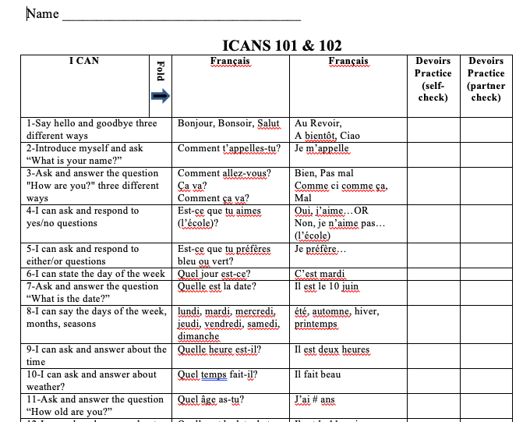
Notes:
Self assessment

Slide 25
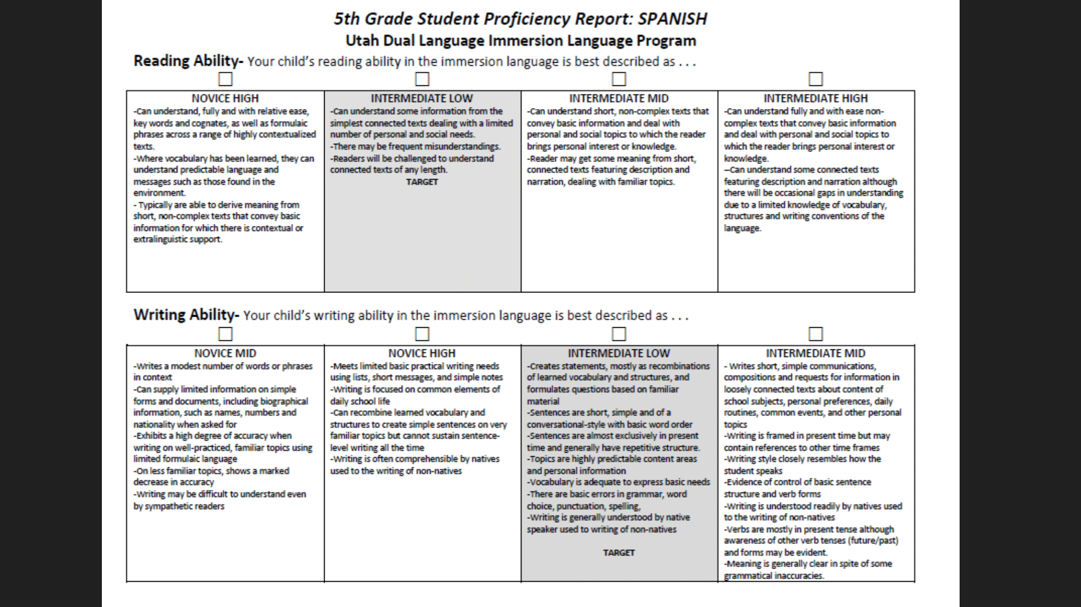

Slide 26
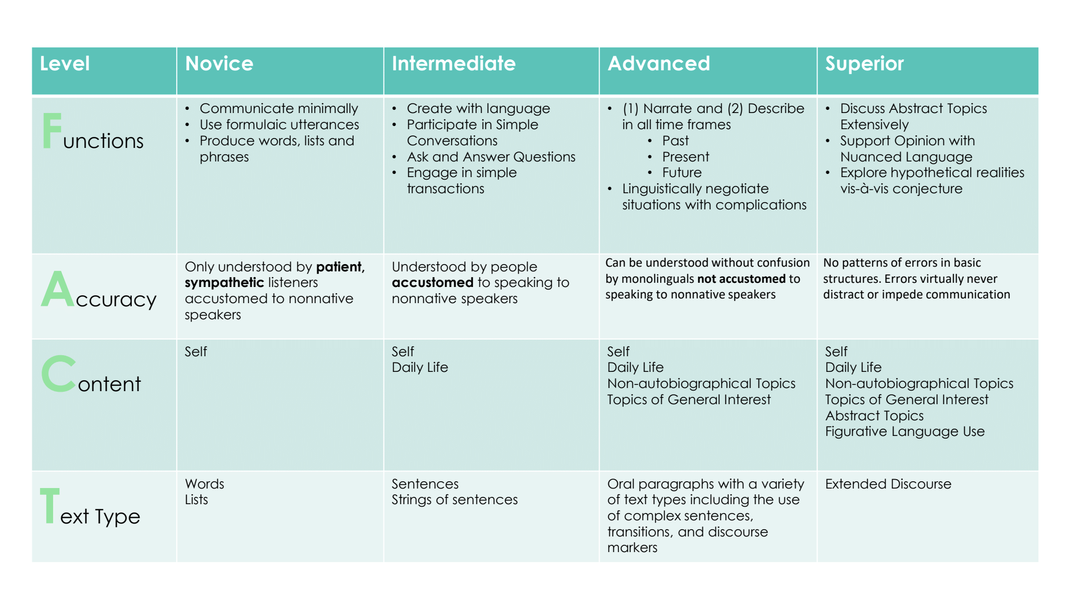
Notes:
In video

Slide 27
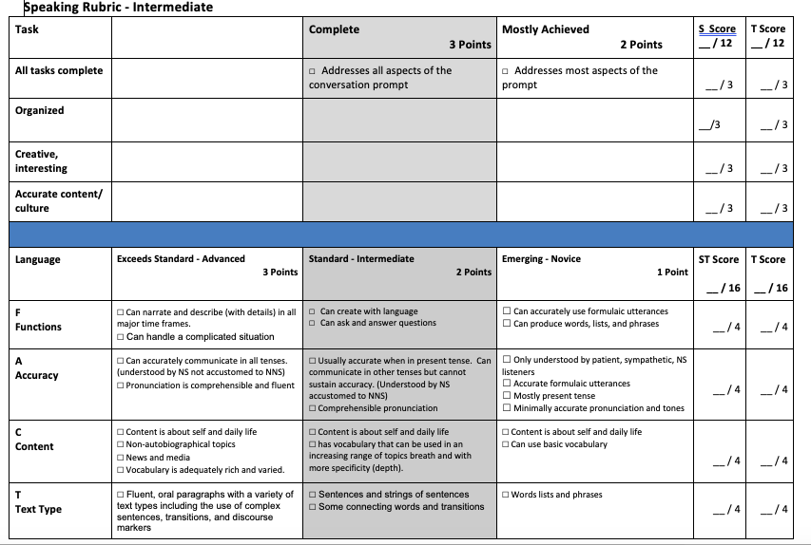

Slide 28
